Slide 1
GEOENGINEERING
Weather Modification
and
Weaponizing Nature
A Presentation by Jim Lee of ClimateViewer News given at the Freedom Force International’s 3rd Congress in Phoenix, Arizona. December 3, 2016
INCONVENIENTLIE.COM
CLIMATEVIEWER.COM
CLIMATEVIEWER.ORG
WEATHERMODIFICATIONHISTORY.COM
Notes:
Presented at G. Edward Griffin’s “Global Warming: an Inconvenient Lie”
http://inconvenientlie.com/
About Jim Lee:
https://climateviewer.com/rezn8d/
ClimateViewer 3D:
http://climateviewer.org/3D/
Reference Pages:
https://climateviewer.com/geoengineering/
https://climateviewer.com/haarp/
https://climateviewer.com/chemtrails/
Weather Modification and Geoengineering Timeline:
http://climateviewer.org/geoengineering-timeline/ > http://weathermodificationhistory.com/ (coming soon)

Slide 2
Global warming alarmists and climate scientists would have you believe that the latest extreme weather events can surely be blamed on rising CO₂ levels while never mentioning the effects of daily weather experiments overhead.
WeatherModificationHistory.com Coming soon

Slide 3
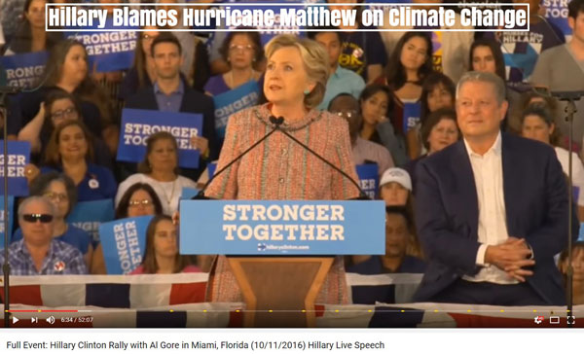
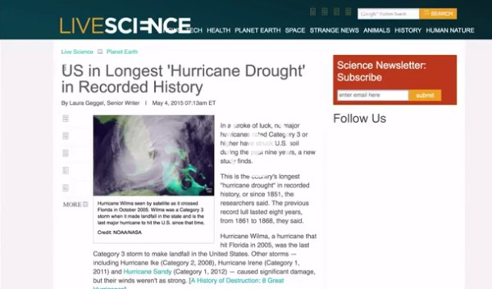
Weather Is Not Climate
“No, weather is NOT climate…even when it’s warm outside. But in case there’s a climate cultist in your life that insists otherwise, here are some facts about global warming, climate change, climate disruption, global weirding and vaguely-defined “extreme” weather that you can use to talk some sense into them.”
www.corbettreport.com/weather-is-not-climate/ James Corbett, The Corbett Report
Notes:
https://www.corbettreport.com/weather-is-not-climate/
https://www.youtube.com/watch?v=i1ytss9lfFs&t=391
http://www.livescience.com/50704-hurricane-drought.html

Slide 4
100 Years Of Weather Control and nobody knew…
Notes:
Now you will

Slide 5
Did you know?
Weather Warfare was banned October 5, 1978
ENMOD
“Environmental Modification Convention”
aka
Convention on the Prohibition of Military or Any Other Hostile Use of Environmental Modification Techniques
Notes:
https://climateviewer.com/2016/01/22/1978-enmod-convention-on-the-prohibition-of-military-and-other-hostile-use-of-environmental-modification-techniques/
Opened for signature May 18, 1977
https://en.wikipedia.org/wiki/Environmental_Modification_Convention
http://www.un-documents.net/enmod.htm

Slide 6
Charles Mallory Hatfield – 1915-1916
The Moisture Accelerator
Created a secret mixture of 23 chemicals in large galvanized evaporating tanks that, he claimed, attracted rain.
Notes:
https://en.wikipedia.org/wiki/Charles_Hatfield
https://climateviewer.com/2014/03/25/history-cloud-seeding-pluviculture-hurricane-hacking/

Slide 7
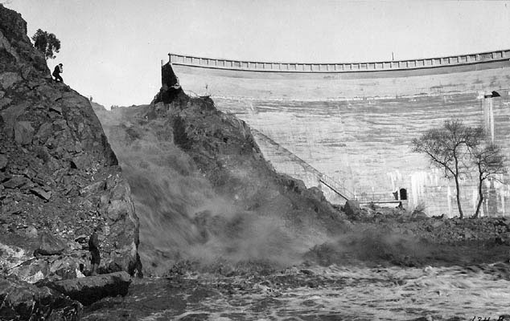
Charles Mallory Hatfield – 1915-1916
Contracted to fill Lake Morena reservoir in San Diego, California.
Never paid $10,000 contract due to $3.5 million flooding.
Notes:
https://en.wikipedia.org/wiki/Charles_Hatfield
In 1915 the San Diego city council, pressured by the San Diego Wide Awake Improvement Club, approached Hatfield to produce rain to fill the Morena Dam reservoir. Hatfield offered to produce rain for free, then charge $1,000 per inch ($393.7 per centimetre) for between forty and fifty inches (1.02 to 1.27 m) and free again over fifty inches (1.27 m). The council voted four to one for a $10,000 fee, payable when the reservoir was filled. A formal agreement was never drawn up, though Hatfield continued based on verbal understanding. Hatfield, with his brother, built a tower beside Lake Morena and was ready early in the New Year.
On January 5, 1916 heavy rain began - and grew gradually heavier day by day. Dry riverbeds filled to the point of flooding. Worsening floods destroyed bridges, marooned trains and cut phone cables - not to mention flooding homes and farms. Two dams, Sweetwater Dam and one at Lower Otay Lake, overflowed. Rain stopped January 20 but resumed two days later. On January 27 Lower Otay Dam broke, increasing the devastation and reportedly causing about 20 deaths (accounts vary on the exact number).
Hatfield talked to the press on February 4 and said that the damage was not his fault and that the city should have taken adequate precautions. Hatfield had fulfilled the requirements of his contract - filling the reservoir - but the city council refused to pay the money unless Hatfield would accept liability for damages; there were already claims worth $3.5 million. Besides, there was no written contract. Hatfield tried to settle for $4000 and then sued the council. In two trials, the rain was ruled an act of God but Hatfield continued the suit until 1938 when two courts decided that the rain was an act of God, which absolved him of any wrongdoing, but also meant he did not get his fee.

Slide 8
The Birth of Cloud Seeding November 13, 1946
Vincent Schaefer, Irving Langmuir, and Bernard Vonnegut
Notes:
https://en.wikipedia.org/wiki/Vincent_Schaefer
https://en.wikipedia.org/wiki/Irving_Langmuir
https://en.wikipedia.org/wiki/Bernard_Vonnegut

Slide 9
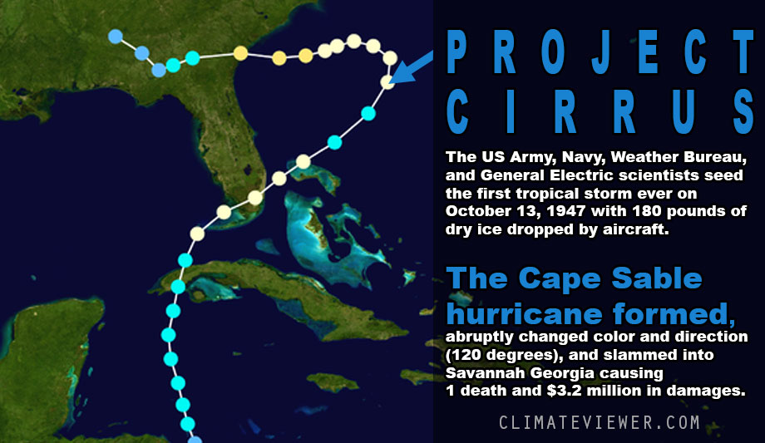
First Hurricane Modification Attempt October 13, 1947
Notes:
http://www.dtic.mil/dtic/tr/fulltext/u2/006880.pdf
http://en.wikipedia.org/wiki/Project_Cirrus
https://climateviewer.com/2016/10/08/is-homeland-security-steering-hurricane-matthew/
The cyclone was historically significant in that it was the first tropical cyclone to be modified as part of a multi-year operation called Project Cirrus. In July 1946, General Electric (GE) scientists concluded after experimentation that dry ice seeding could induce heavy rainfall and thus ultimately weaken storms by cooling temperatures in the eye. To undertake Project Cirrus, GE, the United States Army, the Office of Naval Research, and the U.S. Weather Bureau functioned jointly on research and planning. Early on October 13, 1947, 200 pounds (3,200 oz) of dry ice were dropped throughout the storm, then located about 350 mi (560 km) east of Jacksonville, Florida. While the appearance of the clouds changed, the initial results of the seeding were inconclusive. Shortly after the seeding took place, the hurricane turned sharply toward the Southeastern United States. While the move the leading GE scientist later blamed upon the seeding, subsequent examination of the environment surrounding the storm determined that a large upper-level ridge was in fact responsible for the abrupt turn – Wikipedia: 1947 Cape Sable hurricane
https://en.wikipedia.org/wiki/1947_Cape_Sable_hurricane

Slide 10
Irving P. Krick Invents Ground-based Cloud Seeder - 1949
Notes:
https://en.wikipedia.org/wiki/Irving_P._Krick#Post-war_practice
http://www.winterwatershedconference.org/presentations_2015/History%20of%20Cloud%20Seeding%20in%20AZ%20James%20Walter%20SRP%20Jan%2029%202015.pdf

Slide 11
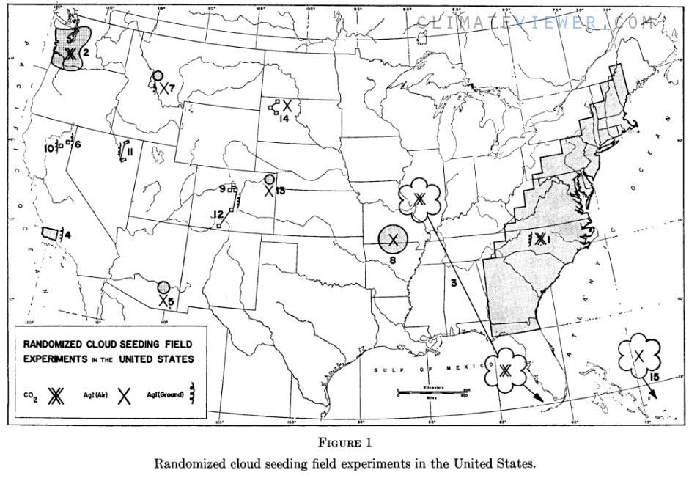
Cloud Seeding Projects 1952 – 1965
Notes:
http://projecteuclid.org/euclid.bsmsp/1200513997
Randomized cloud seeding in the United States. by Court, Arnold. Proceedings of the Fifth Berkeley Symposium on Mathematical Statistics and Probability, Volume 5: Weather Modification, 237–251, University of California Press, Berkeley, Calif., 1967.

Slide 12
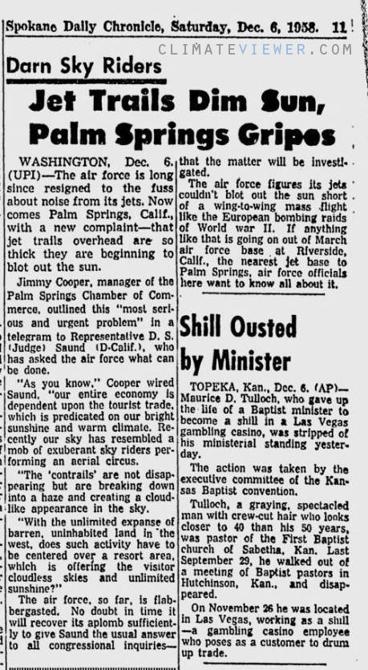
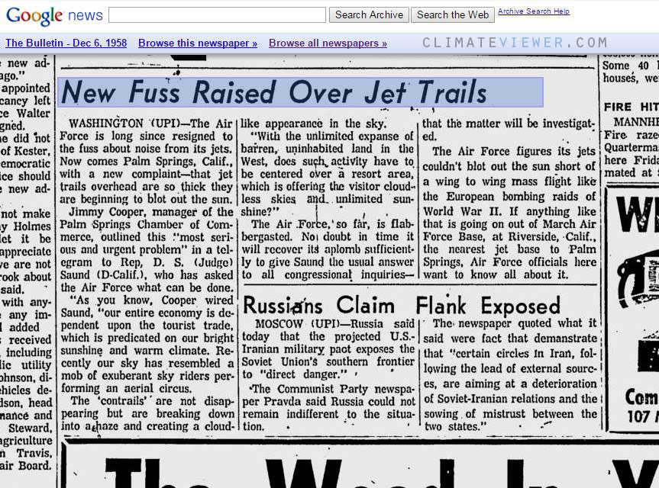
Jet Aircraft’s “Artificial Clouds” Block Sun – 1958
Notes:
New Fuss Raised Over Jet Trails
As you know our entire economy is dependent upon tourist trade, which is predicated on our bright sunshine and warm climate. Recently our sky has resembled a mob of exuberant sky riders performing an aerial circus. The ‘contrails’ are breaking down into a haze and creating a cloud-like appearance in the sky. The Air Force, so far, is flabbergasted.
References
https://news.google.com/newspapers?id=TVNYAAAAIBAJ&sjid=gfcDAAAAIBAJ&pg=5643%2C1072397
https://news.google.com/newspapers?nid=1338&dat=19581206&id=VwBYAAAAIBAJ&sjid=FfcDAAAAIBAJ&pg=6955%2C1632252&hl=en

Slide 13
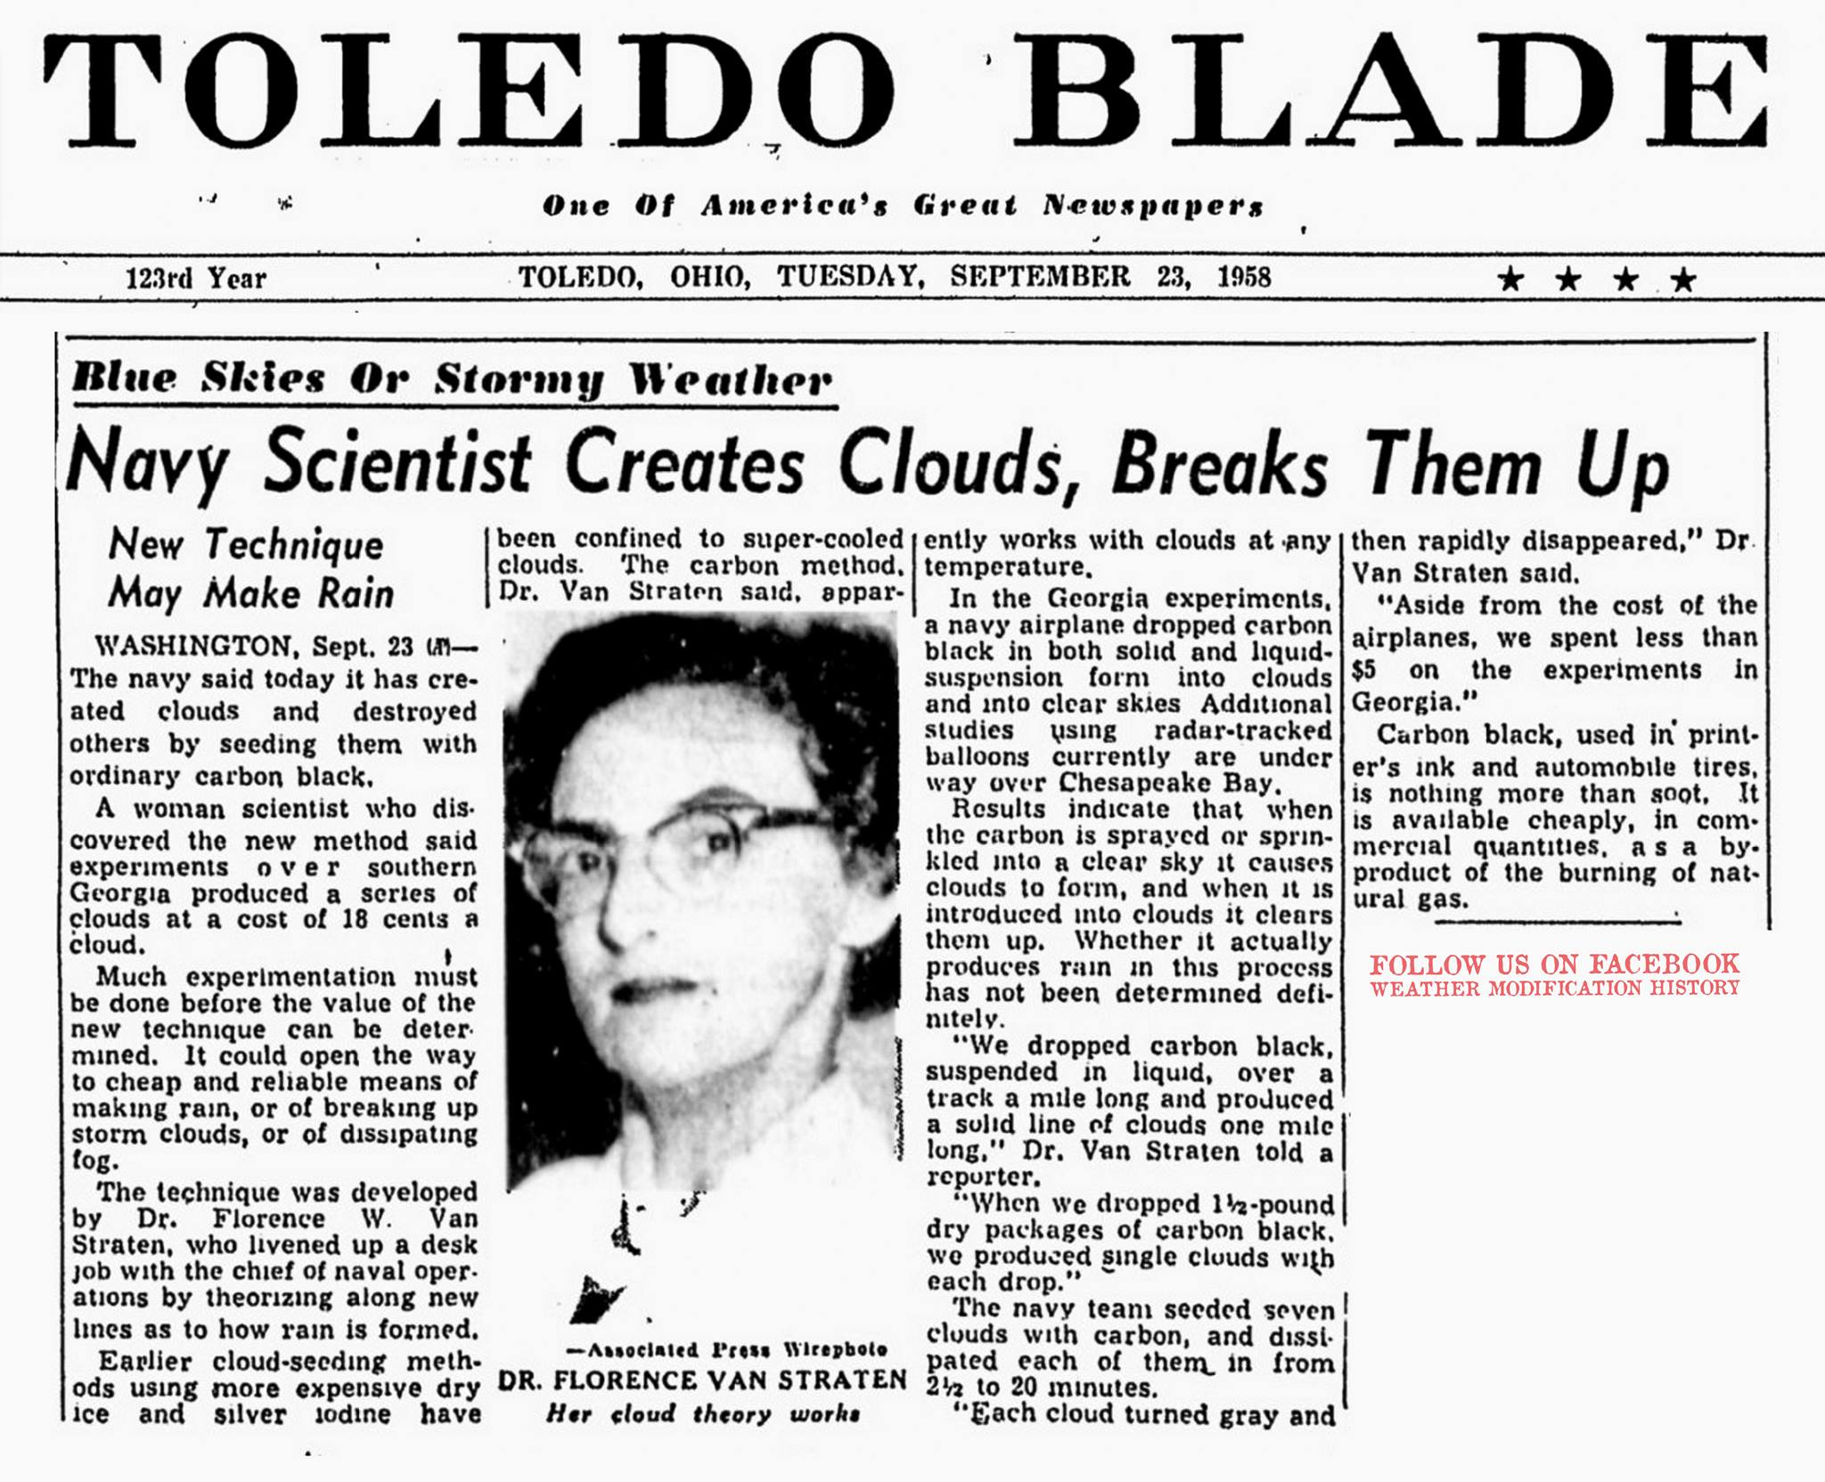
Navy creates/destroys artificial clouds with Carbon Black dust - 1958
Notes:
https://news.google.com/newspapers?id=aghPAAAAIBAJ&sjid=5gAEAAAAIBAJ&pg=1805%2C1211324

Slide 14
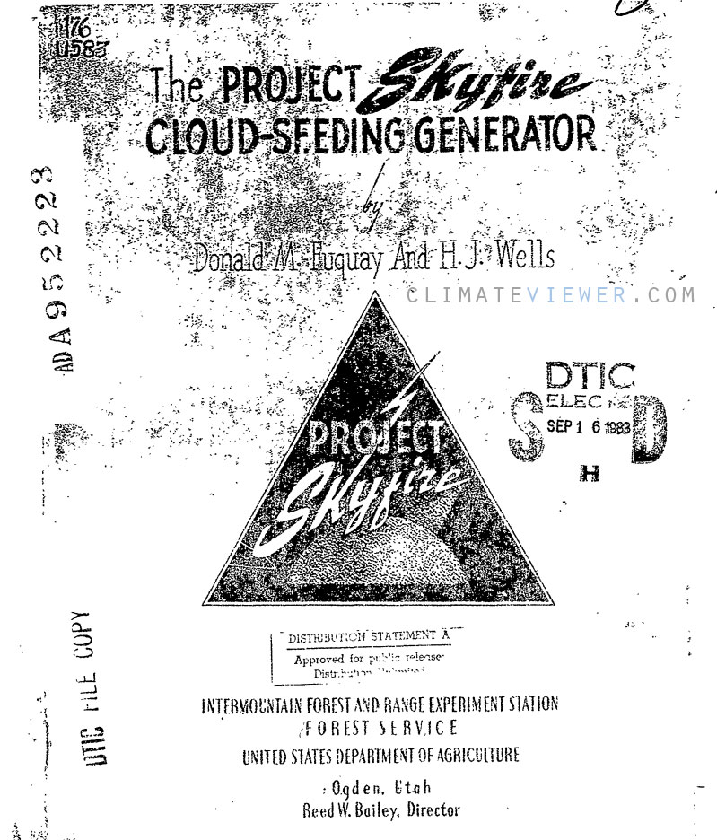
Project Skyfire - 1960-1967
Preventing forest fires with Cloud Seeding
Notes:
cloud seeding and lightning studies (forest fire prevention).
http://www.dtic.mil/dtic/tr/fulltext/u2/a952223.pdf
http://gao.justia.com/national-science-foundation/1972/5/cloud-seeding-activities-carried-out-in-the-united-states-under-programs-supported-by-the-federal-agencies-b-100063/B-100063-full-report.pdf
http://journals.ametsoc.org/doi/pdf/10.1175/1520-0450(1967)006%3C0102%3ACSACTG%3E2.0.CO%3B2

Slide 15
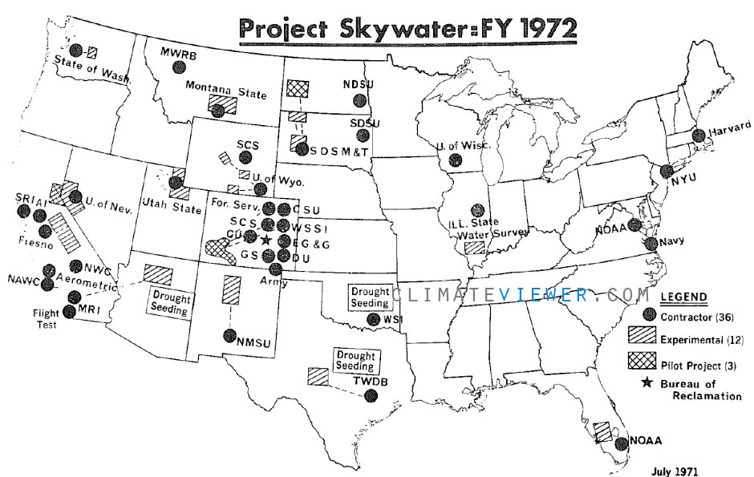
Project Skywater 1961-1988
Notes:
West Coast USA mountain cloud-seeding with Irving P. Krick's ground-based seeders
http://wrri.nmsu.edu/publish/watcon/proc17/Kahan.pdf
https://en.wikipedia.org/wiki/Irving_P._Krick#Post-war_practice

Slide 16
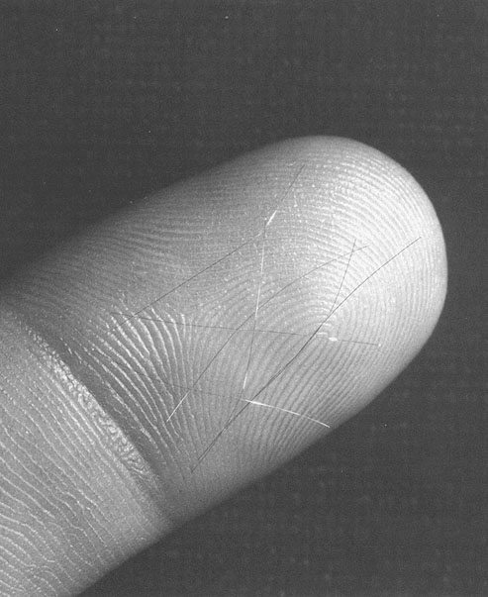
Project West Ford October 21, 1961 ‐ September 5, 1963
Creating an Artificial Ionosphere
480,000,000 copper dipole antennas launched into orbit.
Some are still up there.
Notes:
http://en.wikipedia.org/wiki/Project_West_Ford
http://space.skyrocket.de/doc_sdat/westford.htm

Slide 17
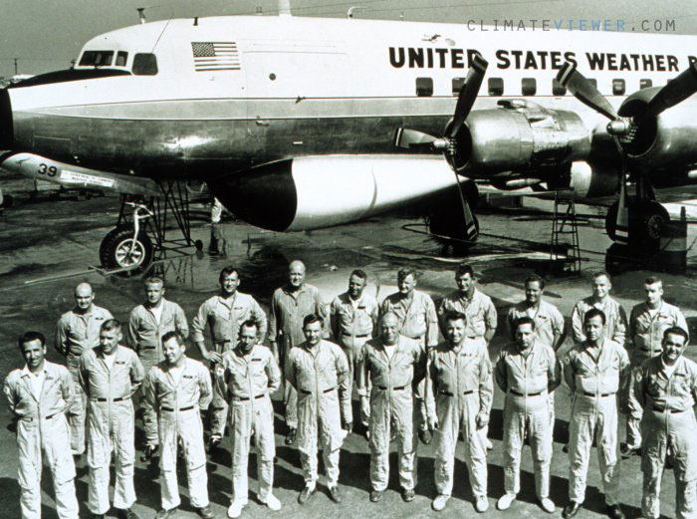
Project Storm Fury August 17, 1962 ‐ 1983
NOAA Hurricane mitigation cloud seeding experiments
Notes:
https://climateviewer.com/2013/11/08/hurricane-hacking-battling-the-big-ones-with-project-stormfury/
http://www.aoml.noaa.gov/hrd/hrd_sub/sfury.html
http://journals.ametsoc.org/doi/pdf/10.1175/1520-0477(1985)066%3C0505:PSASC%3E2.0.CO%3B2
http://www.thelivingmoon.com/45jack_files/03files/Project_Stormfury_NOAA.html

Slide 18
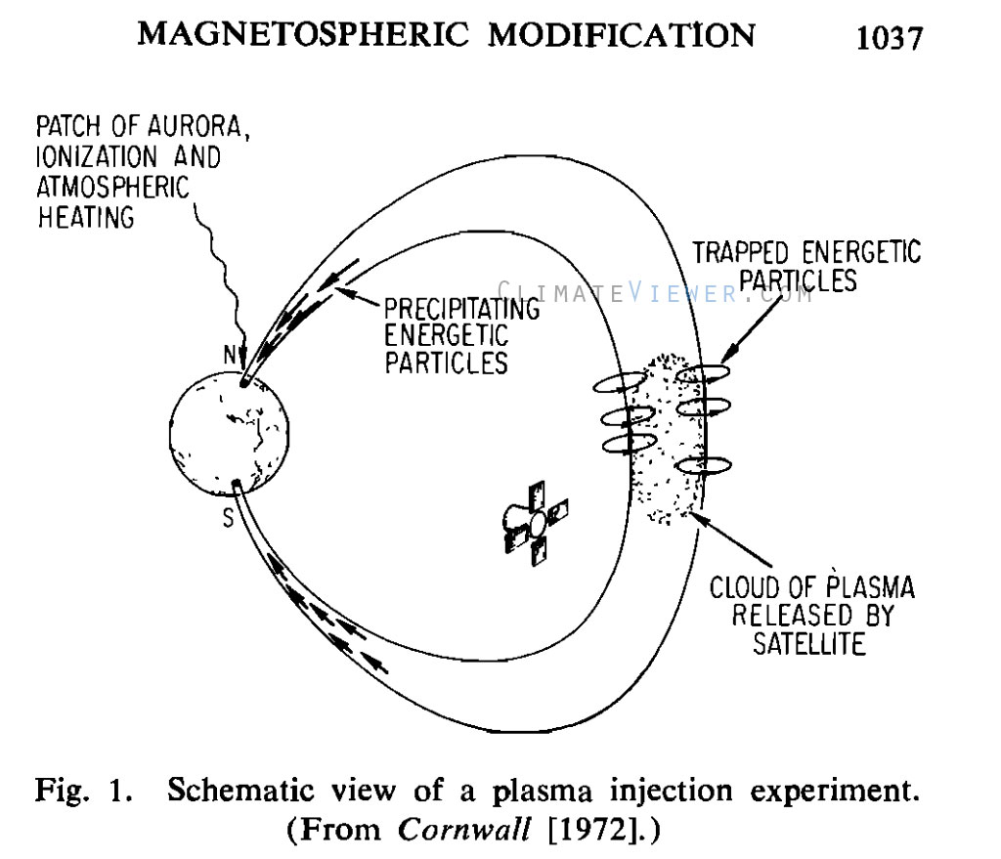
Plasma Seeding Begins – May 1963 Space Weather Modification
“Create an artificial ion cloud in interplanetary space for studying the state of the interplanetary medium .. sounding rocket experiments”
Notes:
http://www.sciencedirect.com/science/article/pii/0032063365901807
http://www.igpp.ucla.edu/public/mkivelso/Publications/019-RS008i011p01035.pdf

Slide 19
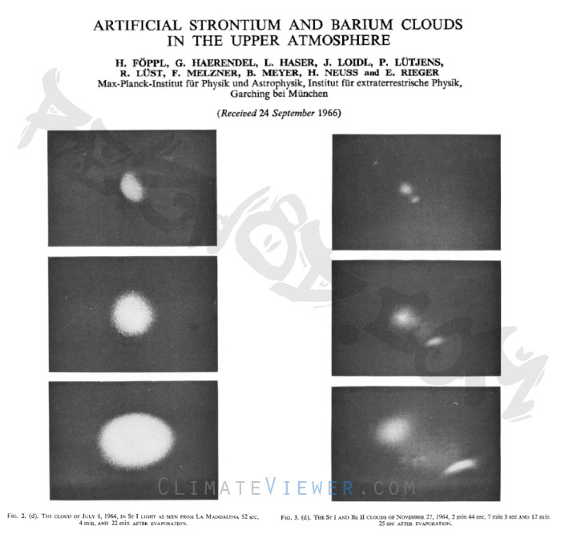
Artificial Strontium and Barium Clouds in the Upper Atmosphere - 1964
“So far seven different experiments have been carried out with sounding rockets in the Sahara and in Sardinia.”
Notes:
http://www.igpp.ucla.edu/public/mkivelso/Publications/019-RS008i011p01035.pdf

Slide 20
“as long as the program was called Solar Energy by the United States, it could not be considered a weapons project.”
Notes:
http://www.nss.org/settlement/ssp/library/1978DOESPS-MilitaryImplications-Ozeroff.pdf
http://r3zn8d.files.wordpress.com/2012/01/1978doesps-militaryimplications-ozeroff.pdf
https://climateviewer.com/2014/09/22/history-haarp-heating-holes-heaven/

Slide 21
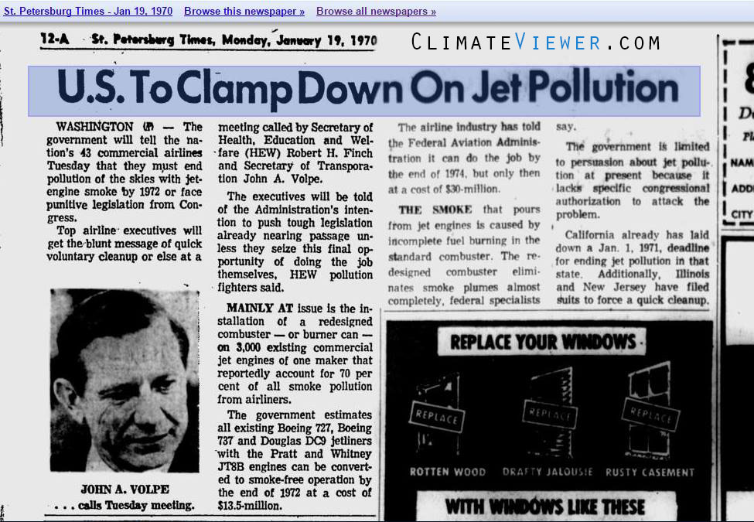
Commercial Airlines To End “Smoke Pollution of the Skies” 1970
Lawsuit by Illinois and New Jersey vs. Airline industry,
Settled out of court by Secretary of Transportation Volpe.
Install “Burner Cans,” reduce particulate emissions by 70%
Notes:
Illinois and New Jersey officials will not settle pollution suits against the nation’s major airlines out of court, despite Tuesday’s agreement between the airlines and the federal government to lean up the jet aircraft exhaust. The government will tell the nation’s 43 commercial airlines Tuesday that they must end pollution of the skies with jet engine smoke by 1972 or face punitive legislation from Congress. Mainly at issue is the installation of a redesigned combuster – or burner can – on 3,000 existing commercial jet engines of one maker that reportedly account for 70 percent of all smoke pollution from airliners. … thus the familiar “black belch” will be seen no more. A jet air plane in one landing and takeoff drenches the environment with as much soot as 2,500 automobiles produce in a entire day… soot, gases of carbon monoxide, aldehydes (irritants in smog), hydrocarbons, and nitrogen oxides. 10,000 tons of particulate matter (three airports) https://news.google.com/newspapers?nid=1982&dat=19700121&id=roJGAAAAIBAJ&sjid=zywNAAAAIBAJ&pg=2670%2C3106142&hl=en
https://news.google.com/newspapers?nid=888&dat=19700119&id=DUtSAAAAIBAJ&sjid=1XsDAAAAIBAJ&pg=6939%2C7171728&hl=en
https://news.google.com/newspapers?nid=1298&dat=19720912&id=M3MQAAAAIBAJ&sjid=R4sDAAAAIBAJ&pg=7178%2C1305490&hl=en
https://news.google.com/newspapers?nid=1964&dat=19710917&id=GMUiAAAAIBAJ&sjid=WrcFAAAAIBAJ&pg=806%2C244201&hl=en

Slide 22
Cloud Seeding Used As Weapon 30 Years After Invention
Notes:
Make it rain on ‘em

Slide 23
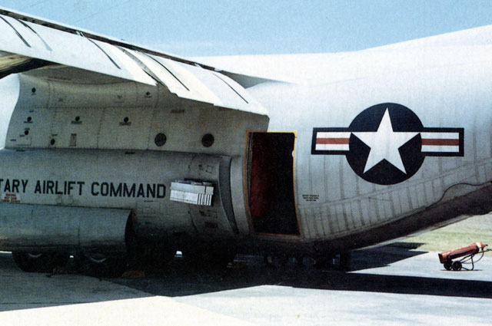
Operation Popeye Weather Warfare over Vitenam
“Make mud, not war”
March 20, 1967 ‐ July 5, 1972
WC-130E with
Silver Iodide
dispenser rack
USAF 54th Weather Reconnaissance Squadron (3 planes total)
Notes:
The following information about the 3 WC-130A aircraft comes from Tom Robison's on line article WHISKEY CHARLIE. Tom is a former Met/ARE troop with both the 55th and 54th WRS. He is probably the foremost authority on all things WC-130, and most things dealing with weather reconnaissance (including atmospheric sampling).
"Few aviation writers and historians seem to be aware that there were three WC-130As. These three were originally trash-haulers, borrowed from TAC in late 1966 for use in Operation "Popeye", the rain-making mission in Southeast Asia, set to begin the following year. The intent of the mission was to create enough year-round rain to keep the Ho Chi Minh trails impassable with mud. Tests were conducted over Laos in 1966, and the operational missions began in March of 1967 from Udorn RTAFB, Thailand. They were flown by crews of the 54th WRS, rotated on a regular basis from Guam. In addition, 54th crews were sometimes called upon to conduct synoptic weather reconnaissance from Udorn over various areas of Southeast Asia, out to and including the Bay of Bengal.
The A-models were modified for weather reconnaissance, probably at WRAMA, with the AN/AMR-1 system. They were not configured for atmospheric sampling. Two were kept at Udorn, with the third rotating to and from Guam for maintenance, repair, and crew changes, from June 1967 through late 1970. When the third one was not enroute to/from Thailand, it was used for normal weather reconnaissance activities from Guam. In late 1970 the A's were replaced with three 1958 B-models, and the rain-making mission continued through mid-1972 with whichever B- or E-models were available from the 54th. After re-conversion to transport, the A's were transferred to Air Force Reserve units. During their brief stint as rain-makers, they flew a total of 1435 "combat" sorties, and it is reported that at least one of them received battle damage. All three A-models wore the standard Southeast Asia camouflage colors and markings, but with no unit designations of any kind. In 1973, 56-0519 was given or loaned to the South Vietnamese Air Force, and it became one of the spoils of war on April 30, 1975. The last reliable sighting was in April of 1999, which reported her corroded and derelict at Tan Son Nhut Airport, Ho Chi Minh City.“
http://www.awra.us/gallery-jan05.htm

Slide 24
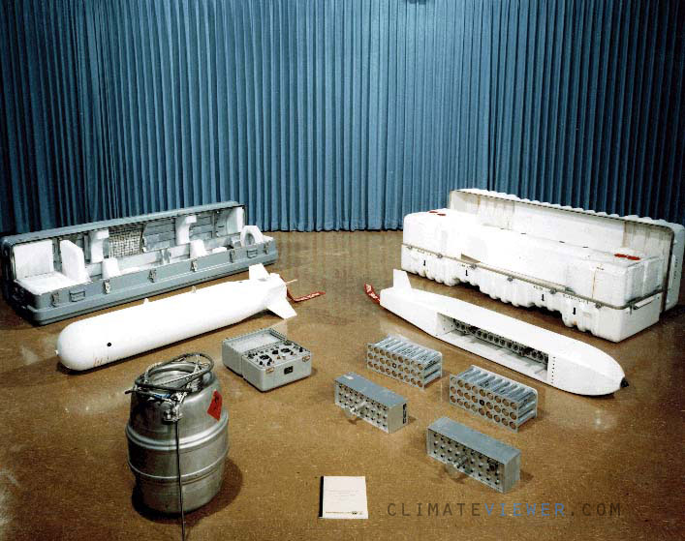
Operation Popeye Weather Warfare over Vitenam
GOALS
Softening road surfaces
Causing landslides along roadways
Washing out river crossings
Maintain saturated soil conditions beyond the normal time span.
Notes:
PICTURED: The Cold Cloud Modification System, successfully used in cold-fog mitigation; China Lake was for many years a world leader in weather modification for drought relief (GROMET), hurricane abatement (Cyclops, Stormfury), fog abatement (Foggy Cloud), and rainfall enhancement for military purposes (Project Popeye).
References
http://en.wikipedia.org/wiki/Operation_Popeye
http://www.awra.us/gallery-jan05.htm

Slide 25
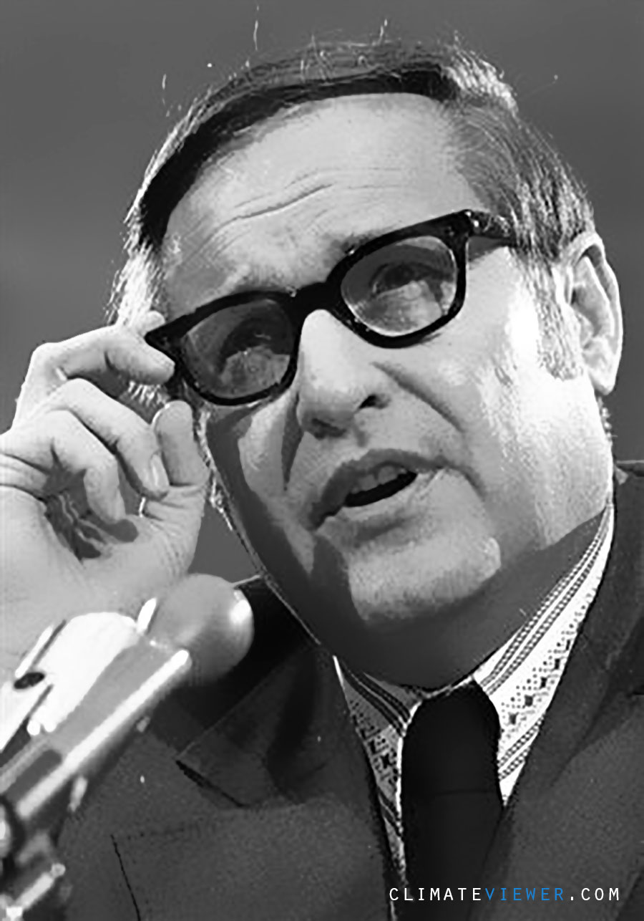
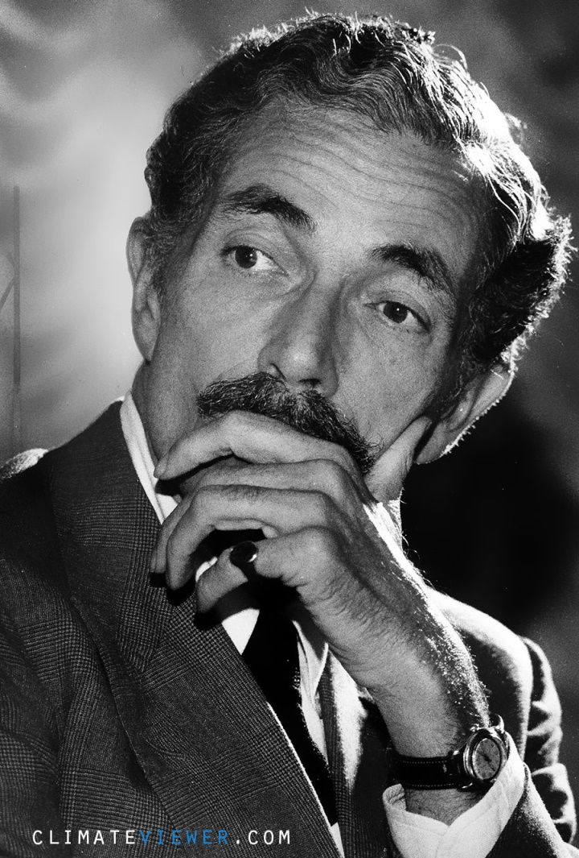
Operation Popeye BUSTED!
Reporter Jack Anderson
Senator Claiborne Pell
Operation Popeye first came to public light in March 1971, when reporter Jack Anderson published a story based on a secret 1967 memo from the Joint Chiefs of Staff to President Johnson. The memo read: “Laos operations – Continue as at present plus Pop Eye to reduce the trafficability [sic] along infiltration routes & Authorization requested to implement operational phase of weather modification process previously successful tested and evaluated in some area”.
Saw a secret memo
Held secret hearings
Notes:
Operation Popeye first came to public light in March 1971, when reporter Jack Anderson published a story based on a secret 1967 memo from the Joint Chiefs of Staff to President Johnson. The memo read: “Laos operations – Continue as at present plus Pop Eye to reduce the trafficability [sic] along infiltration routes & Authorization requested to implement operational phase of weather modification process previously successful tested and evaluated in some area”. (US Senate, Subcommittee on Oceans and International Environment; 26 July 1972; p. 5). Mr DOOLIN: I speak in a personal capacity and not in my official capacity, Mr. Chairman. I have been in this job for 5 years, and I didn't have this clearance even though Southeast Asia is in my area of responsibility in the Office of the Secretary of Defense. The first I learned of it was, as the result of a Jack Anderson column, and I made inquiries at the time - simply for my own edification... [US Senate, Subcommittee on Oceans and International Environment; 20 March 1972; p. 111]
https://climateviewer.files.wordpress.com/2016/11/top-secret-hearings-before-the-subcommittee-on-oceans-and-international-environment-march-20-1974-enmod.pdf
https://en.wikipedia.org/wiki/Jack_Anderson_(columnist) - https://en.wikipedia.org/wiki/Claiborne_Pell - http://www.nbcnews.com/id/39157420/ns/politics/t/nixon-plot-against-newspaper-columnist-detailed/

Slide 26
Weather Warfare Politics Weather modification meets full disclosure

Slide 27
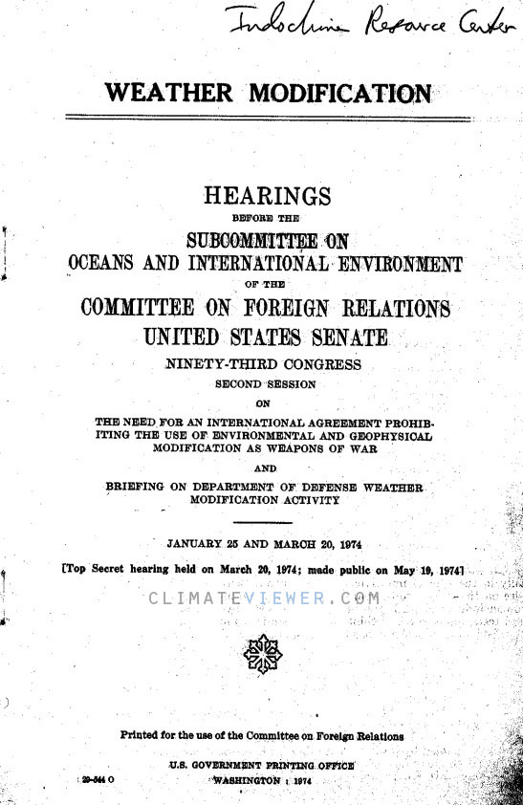
Top Secret Congressional Hearings
January 25, March 20, and July 26, 1974
Benjamin Forman, a senior Department of Defense lawyer, reiterated [Secretary of Defense Melvin] Laird’s denial later that year:
“We have not, as Secretary Laird has previously said, ever engaged in weather modification activities in Northern Vietnam.”
Discussing the need for ENMOD
Notes:
Laird wasn’t the only official whose 1972 weather modification testimony was untruthful. Benjamin Forman, a senior Department of Defense lawyer, reiterated Laird’s denial later that year: “We have not, as Secretary Laird has previously said, ever engaged in weather modification activities in Northern Vietnam.” At the same hearing, the Deputy Director of the US Arms Control and Disarmament Agency had similar difficulties. Asked by Senator Pell if rainmaking projects had been approved by Laos and Thailand, Philip Farley replied: “I don’t wish even to admit, sir, that there were such projects.” http://web.archive.org/web/20120910101837/http://www.sunshine-project.org/enmod/US_Congr.html – The Limits of Inside Pressure: The US Congress Role in ENMOD, by The Sunshine Project. Retrieved 2012.
https://climateviewer.com/2016/01/22/1978-enmod-convention-on-the-prohibition-of-military-and-other-hostile-use-of-environmental-modification-techniques/
[US Senate, Subcommittee on Oceans and International Environment; 26 July 1972] REFERENCE MISSING… FILE NEEDED – CLASSIFIED
[US Senate, Subcommittee on Oceans and International Environment; January 25, March 20, 1972]
https://climateviewer.files.wordpress.com/2016/11/top-secret-hearings-before-the-subcommittee-on-oceans-and-international-environment-march-20-1974-enmod.pdf
https://www.scribd.com/document/332402260/TOP-SECRET-Hearings-Before-the-Subcommittee-on-Oceans-and-International-Environment-March-20-1974-ENMOD
HEARINGS BEFORE THE SUBCOMMITTEE ON OCEANS AND INTERNATIONAL ENVIRONMENT OF THE COMMITTEE ON FOREIGN RELATIONS UNITED STATES SENANTE NINETY-THIRD CONGRESS SECOND SESSION ON THE NEED FOR AN INTERNATIONAL AGREEMENT PROHIBITING THE USE OF ENVIRONMENTAL AND GEOPHYSICAL MODIFICATION AS WEAPONS OF WAR AND BRIEFING ON DEPARTMENT OF DEFENSE WEATHER MODIFICATION ACTIVITY JANUARY 25 AND MARCH 20, 1974 [Top Secret hearing held on March 20, 1974; made public on May 19, 1974] Printed for the use of the Committee on Foreign Relations US GOVERNMENT PRINTING OFFICE PDF obtained from http://www.vietnam.ttu.edu/virtualarchive/items.php?item=2390601002 in three parts. Combined by Jim Lee of ClimateViewer News https://climateviewer.com/ and uploaded to Scribd for public domain consumption.

Slide 28
Weather Modification Reporting Laws
Weather Modification Reporting Act of 1972 – Public Law 92-205 “AN ACT To provide for the reporting of weather modification activities to the Federal Government” 15 CFR Part 908 — “Maintaining Records and Submitting Reports on Weather Modification Activities”
National Weather Modification Policy Act of 1976 – Public Law 94-490 “AN ACT To authorize and direct the Secretary of Commerce to develop a national policy on weather modification, and for other purposes” 15 U.S. Code Chapter 9A – “Weather Modification Activities or Attempts; Reporting Requirement”
Notes:
http://www.gpo.gov/fdsys/pkg/STATUTE-85/pdf/STATUTE-85-Pg735.pdf – http://web.archive.org/web/20130118170030/http://uscode.house.gov/download/pls/15C9A.txt – Public Law 92-205, Sec. 1, Dec. 18, 1971, 85 Stat. 735
http://cfr.regstoday.com/15cfr908.aspx – 15 CFR 908 — “Maintaining Records and Submitting Reports on Weather Modification Activities”
http://web.archive.org/web/20121119043808/http://www.corporateservices.noaa.gov/~noaaforms/eforms/nf17-4.pdf – NOAA Form 17-4 “Initial Report on Weather Modification Activities” Expired 2008
http://web.archive.org/web/20130218182517/http://www.corporateservices.noaa.gov/~noaaforms/eforms/nf17-4a.pdf – NOAA Form 17-4a “Interim Activity Reports and Final Report” Expired 2007
http://www.gpo.gov/fdsys/pkg/STATUTE-90/pdf/STATUTE-90-Pg2359.pdf Public Law 94-490 94th Congress “AN ACT To authorize and direct tlie Secretary of Commerce to develop a national policy on weather modification, and for other purposes” 1976
https://www.law.cornell.edu/uscode/text/15/chapter-9A – 15 U.S. Code Chapter 9A – “Weather Modification Activities or Attempts; Reporting Requirement”

Slide 29
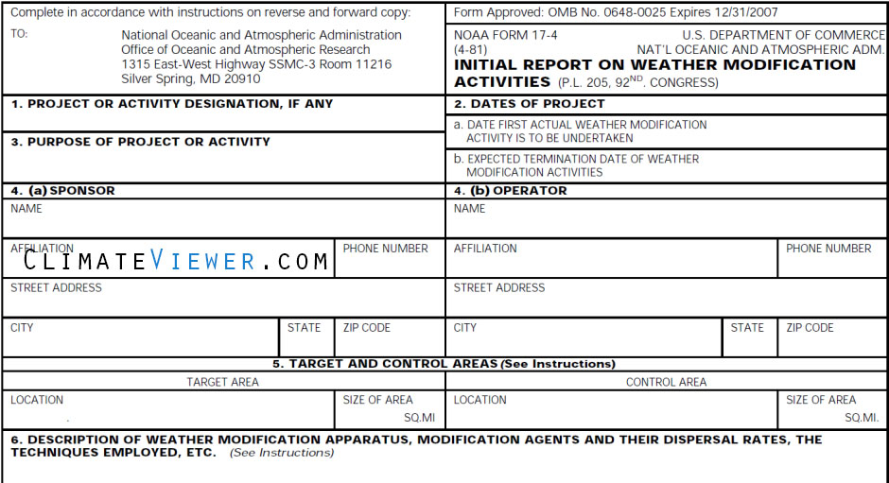
Weather Modification Reporting Forms
Notes:
https://www.scribd.com/doc/255211130/Initial-Report-on-Weather-Modification-Activities-NOAA-Form-17-4-Nf17-4
https://www.scribd.com/document/255218096/Weather-Modification-Interim-Activity-Reports-and-Final-Report-NOAA-Form-17-4A-Nf17-4a
http://web.archive.org/web/20121119043808/http://www.corporateservices.noaa.gov/~noaaforms/eforms/nf17-4.pdf – NOAA Form 17-4 “Initial Report on Weather Modification Activities” Expired 2008
http://web.archive.org/web/20130218182517/http://www.corporateservices.noaa.gov/~noaaforms/eforms/nf17-4a.pdf – NOAA Form 17-4a “Interim Activity Reports and Final Report” Expired 2007

Slide 30
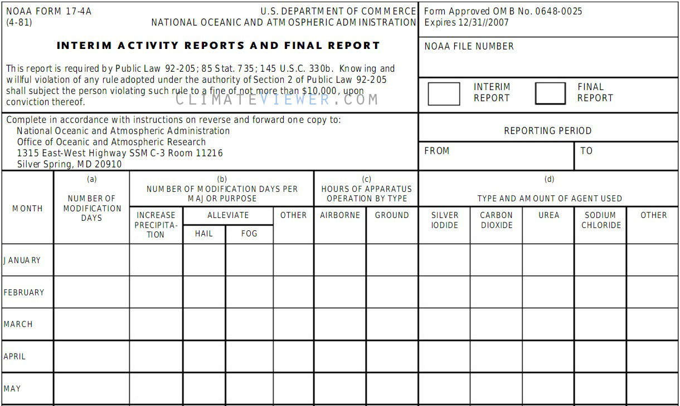
Weather Modification Reporting Forms
Notes:
https://www.scribd.com/doc/255211130/Initial-Report-on-Weather-Modification-Activities-NOAA-Form-17-4-Nf17-4
https://www.scribd.com/document/255218096/Weather-Modification-Interim-Activity-Reports-and-Final-Report-NOAA-Form-17-4A-Nf17-4a
http://web.archive.org/web/20121119043808/http://www.corporateservices.noaa.gov/~noaaforms/eforms/nf17-4.pdf – NOAA Form 17-4 “Initial Report on Weather Modification Activities” Expired 2008
http://web.archive.org/web/20130218182517/http://www.corporateservices.noaa.gov/~noaaforms/eforms/nf17-4a.pdf – NOAA Form 17-4a “Interim Activity Reports and Final Report” Expired 2007

Slide 31
ENMOD Weather Warfare Ban
Opened for signature May 18, 1977 Signed October 5, 1978
Notes:
They signed a piece of paper.

Slide 32
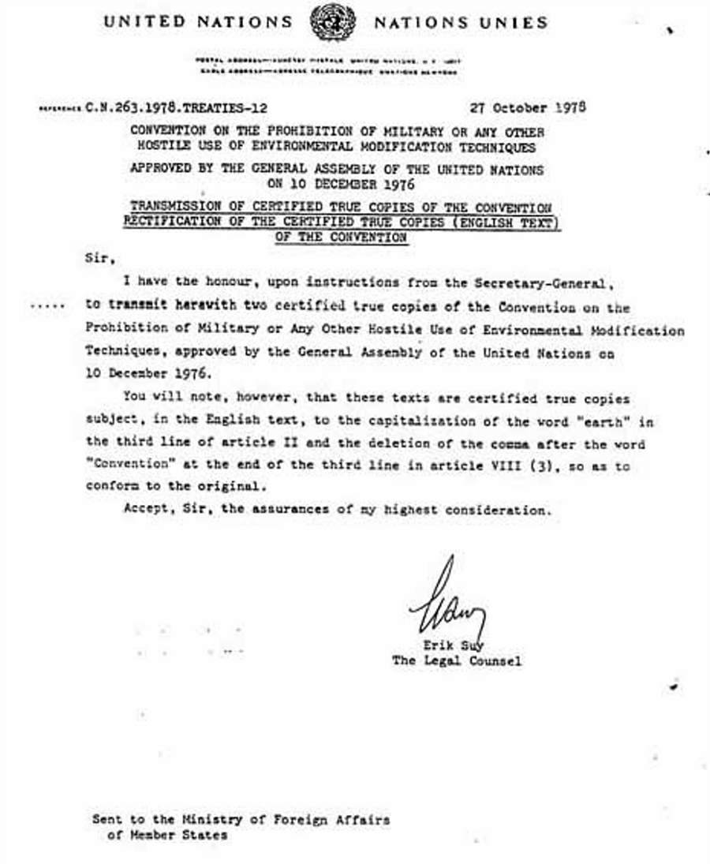
ENMOD Weather Warfare Ban
“Each State Party to this Convention undertakes not to engage in military or any other hostile use of environmental modification techniques having widespread, long-lasting or severe effects as the means of destruction, damage or injury to any other State Party”
REQUIRES HOSTILE INTENT
Notes:
State Department representative Herman Pollack told the Congress at a 1972 hearing that:
“the administration would not use techniques for climate modification for hostile purposes even should they become available”
“Primarily the work is aimed at giving the US Navy and the other armed forces, if they should care to use it, the capability of modifying the environment, to their own advantage, or to the disadvantage of an enemy.
We regard the weather as a weapon. Anything one can use his way is a weapon and the weather is as good a one as any.”
(Quoted in: US Senate, Subcommittee on Oceans and International Environment; 26 July 1972; p. 22, emphasis added).
https://climateviewer.com/2016/01/22/1978-enmod-convention-on-the-prohibition-of-military-and-other-hostile-use-of-environmental-modification-techniques/

Slide 33
Weather Modification: Programs, Problems, Policy, and Potential
May 1978
784 page accounting of weather modification activities in the USA
Notes:
Governments full accounting of all weather modification activities in the United States of America as a result of ENMOD.
“The report was prepared at my request by the Congressional Research Service under the direction of Dr. Robert Morrison, Specialist in Earth Sciences, Science Policy Research Division. We thank Dr. Morrison and the others involved in the study for their extremely thorough and scholarly report. Substantial material on almost all areas of weather modification are included and the report will provide the committee with an excellent reference source for future deliberations on the subject”
https://archive.org/details/weatificat00unit
https://www.scribd.com/doc/275655074/WEATHER-MODIFICATION-PROGRAMS-PROBLEMS-POLICY-AND-POTENTIAL

Slide 34
Summary of Weather Modification Activities Reported in 1979
Notes:
Cloud seeding:
4,796 hours airborne
31,210 hours ground-based
https://www.scribd.com/document/332125391/Summary-of-Weather-Modification-Activities-Reported-in-1979-NOAA

Slide 35
ENMOD Has No Teeth
ENMOD is just an agreement (paper)
No way to detect weather warfare
No way to prove case
No way to enforce punishment
#WTF
Notes:
It is really weak, really

Slide 36
Where Are We Today? The Blue Gold Rush “Fresh water has been dubbed “Blue Gold” in many publications as potable water will be to this century what oil was to the last century. ”
Notes:
The Twilight Zone
https://climateviewer.com/2014/02/02/blue-gold-rush-future-water-wars-using-rivers-troposphere/

Slide 37
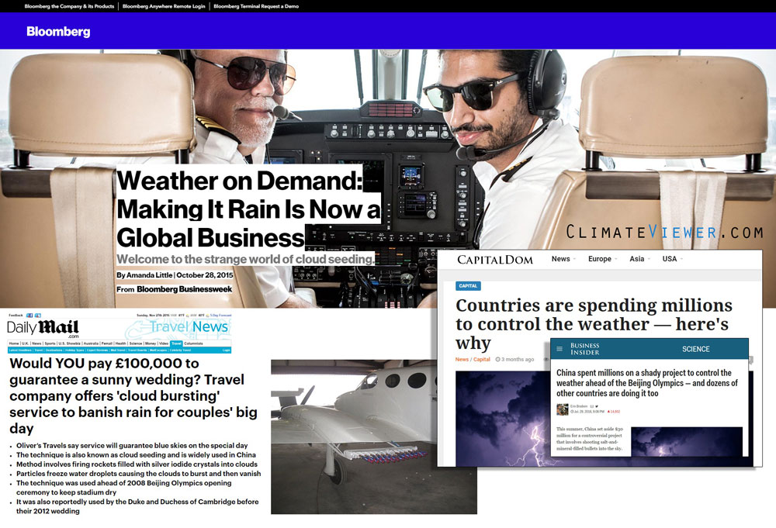
Cloud Seeding is Big Business
Notes:
http://www.bloomberg.com/features/2015-cloud-seeding-india/
http://capitaldom.com/countries-are-spending-millions-to-control-the-weather-heres-why
http://www.businessinsider.com/china-sets-aside-millions-to-control-the-rain-2016-7
http://www.dailymail.co.uk/travel/travel_news/article-2926736/Would-pay-100-000-guarantee-sunny-wedding-Travel-company-offers-cloud-bursting-service-banish-rain-couples-big-day.html
http://www.oliverstravels.com/blog/guarantee-perfect-wedding-weather-olivers-travels/?olv=sGmkd0
https://www.theguardian.com/sustainable-business/2015/mar/11/rain-free-weddings-company

Slide 38
Cloud Seeding Projects Worldwide
climateviewer.org/3D/
Notes:
http://climateviewer.org/3D/

Slide 39
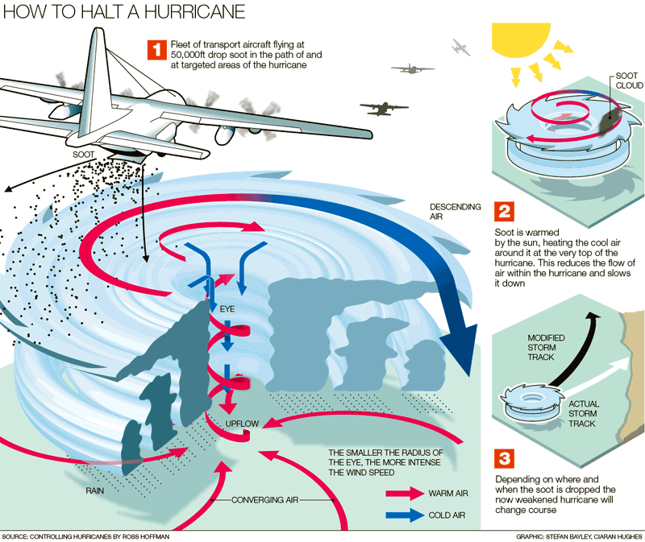
Homeland Security Hurricane Control
“The Hurricane Modification Workshop was initiated by Under Secretary Jay Cohen, DHS S&T, to investigate the possibility of minimizing the tremendous loss of life, property, and economic stability by reducing the destructive forces of a hurricane. This may be accomplished by modifying its track, speed, winds, and rain.”
Notes:
https://climateviewer.com/2013/11/08/hurricane-hacking-the-department-of-homeland-security-enters-the-weather-modification-business/

Slide 40
Homeland Security Hurricane Control
Notes:
1. Mr. William Laska – Department of Homeland Security
2. Dr. Edward Hume – Johns Hopkins University Applied Physics Laboratory
3. Dr. Joe Golden – National Oceanic and Atmospheric Administration
4. Dr. William Cotton – Colorado State University
5. Dr. Bob Kurzeja – Savannah River National Laboratory
6. Dr. Alan Blumberg – Stevens Institute of Technology
7. Dr. Jerald Carithers – University of Southern Mississippi
8. Dr. William Woodley – Woodley Weather Consultants
9. Dr. Jay Hobgood – Ohio State University
10. Dr. Moshe Alamaro – Massachusetts Institute of Technology
11. Dr. Stephen Salter University of Edinburgh
12. Dr. Daniel Rosenfeld – Hebrew University
13. Dr. Mark DeMaria – National Oceanic and Atmospheric Administration
14. Dr. Edward Walsh – National Oceanic and Atmospheric Administration
15. Dr. Isaac Ginis – University of Rhode Island
16. Dr. John Latham – University Corporation for Atmospheric Research
17. Dr. Patrick Fitzpatrick – Mississippi State University
18. Dr. Sundararaman Gopalakrishnan – National Oceanic and Atmospheric Administration
19. Ms. Paula Lantzer – Department of Homeland Security
Not Pictured: Dr. Roelof Bruintjes – National Center for Atmospheric Research

Slide 41
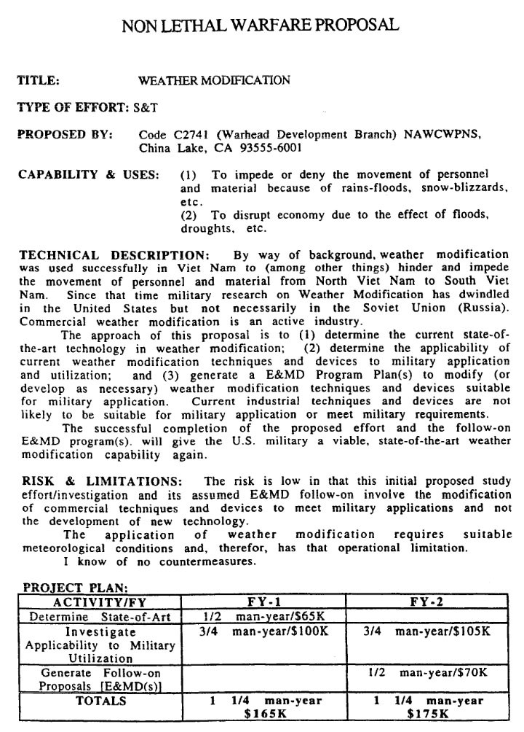
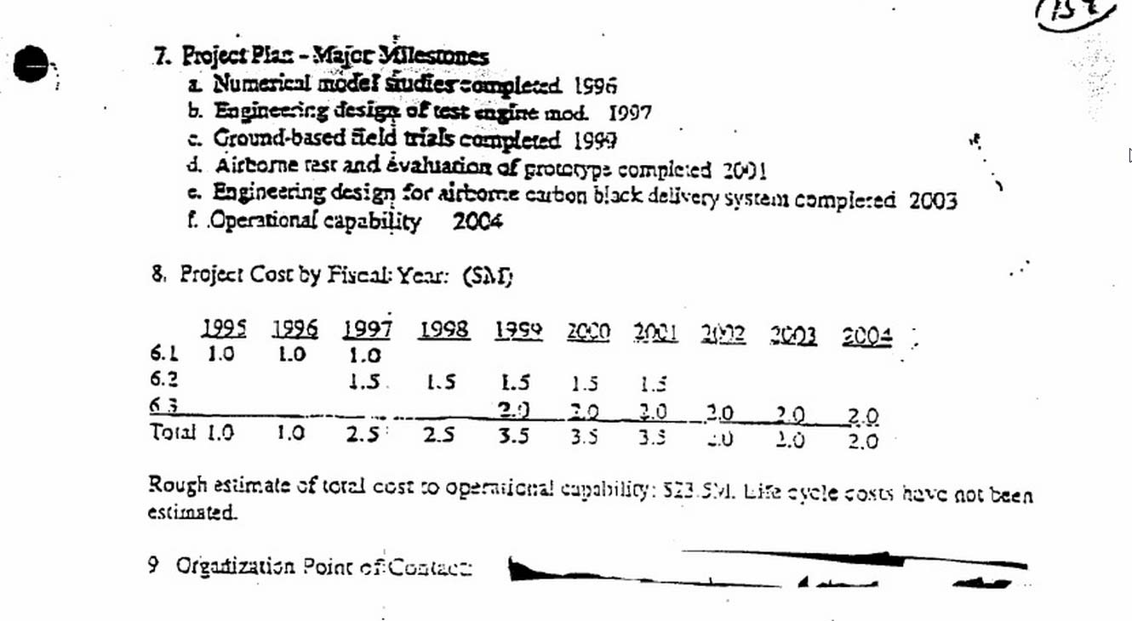
US Military Violating ENMOD 1994 FOIA – USAF Phillips Lab, USN China Lake
Notes:
Jim Lee, “US military discusses future of Weather Warfare despite ENMOD ban,” November 16, 2013. https://climateviewer.com/2013/11/16/us-military-discusses-future-of-weather-warfare-despite-enmod-ban/
The U.S. Navy proposal to develop new weather modification weapons, Code C2741 (Warhead Development Branch) NAWCWPNS, China Lake, California, April 1994, https://www.scribd.com/doc/256210692/Weather-Modification-US-Navy-FOIA-Non-Lethal-Warfare-Proposal-1994 ;
U.S. Air Force proposal to develop a theater-scale weather modification system using carbon black, Phillips Laboratory (AFMC) Geophysics Directorate. https://www.scribd.com/doc/184741384/Weather-Modification-Using-Carbon-Black-Phillips-Laboratory-AFMC-Geophysics-Directorate
Tamzy J. House et al. “Weather As A Force Multiplier: Owning the Weather in 2025,” Air Force 2025, August 1996; see page 34, Figure 5-2, “A Systems Development Road Map to Weather Modification in 2025.” http://csat.au.af.mil/2025/volume3/vol3ch15.pdf

Slide 42
US Military Violating ENMOD 1995-1997 – AF2025, WXMOD Test Technology Symposium ’97
Notes:
Jim Lee, “US military discusses future of Weather Warfare despite ENMOD ban,” November 16, 2013. https://climateviewer.com/2013/11/16/us-military-discusses-future-of-weather-warfare-despite-enmod-ban/
The U.S. Navy proposal to develop new weather modification weapons, Code C2741 (Warhead Development Branch) NAWCWPNS, China Lake, California, April 1994, https://www.scribd.com/doc/256210692/Weather-Modification-US-Navy-FOIA-Non-Lethal-Warfare-Proposal-1994 ;
U.S. Air Force proposal to develop a theater-scale weather modification system using carbon black, Phillips Laboratory (AFMC) Geophysics Directorate. https://www.scribd.com/doc/184741384/Weather-Modification-Using-Carbon-Black-Phillips-Laboratory-AFMC-Geophysics-Directorate
Tamzy J. House et al. “Weather As A Force Multiplier: Owning the Weather in 2025,” Air Force 2025, August 1996; see page 34, Figure 5-2, “A Systems Development Road Map to Weather Modification in 2025.” http://csat.au.af.mil/2025/volume3/vol3ch15.pdf

Slide 43
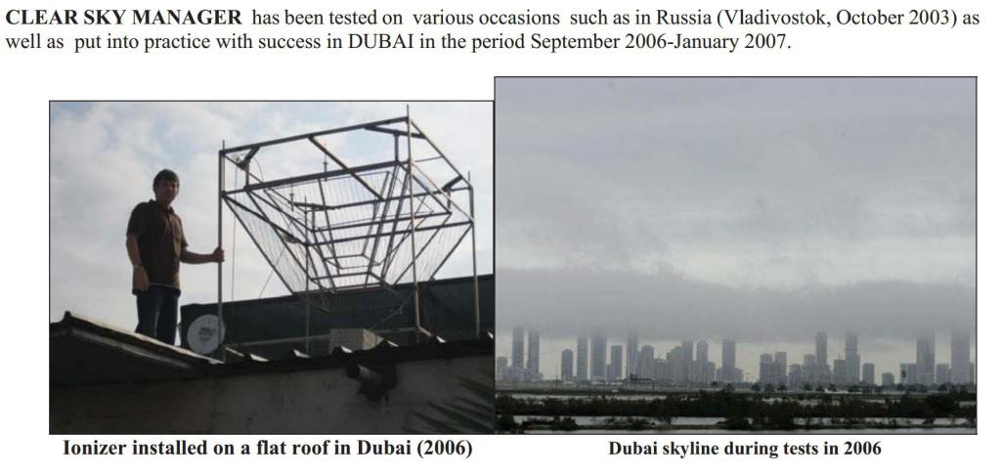
Cloud Ionizers – Electric Rainmaking
Notes:
https://climateviewer.com/2014/03/26/cloud-ionization-electric-rainmaking-laser-guided-weather-modification/
https://climateviewer.com/2014/02/02/blue-gold-rush-future-water-wars-using-rivers-troposphere/

Slide 44
Cloud Ionizers – Electric Rainmaking
Notes:
https://climateviewer.com/2015/05/28/how-texas-stole-californias-rain/
https://climateviewer.com/2014/03/26/cloud-ionization-electric-rainmaking-laser-guided-weather-modification/
https://climateviewer.com/2014/02/02/blue-gold-rush-future-water-wars-using-rivers-troposphere/

Slide 45
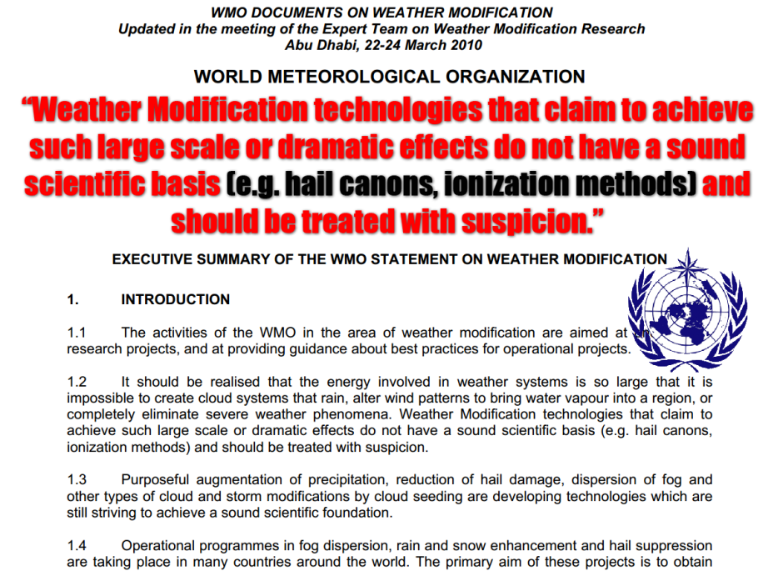
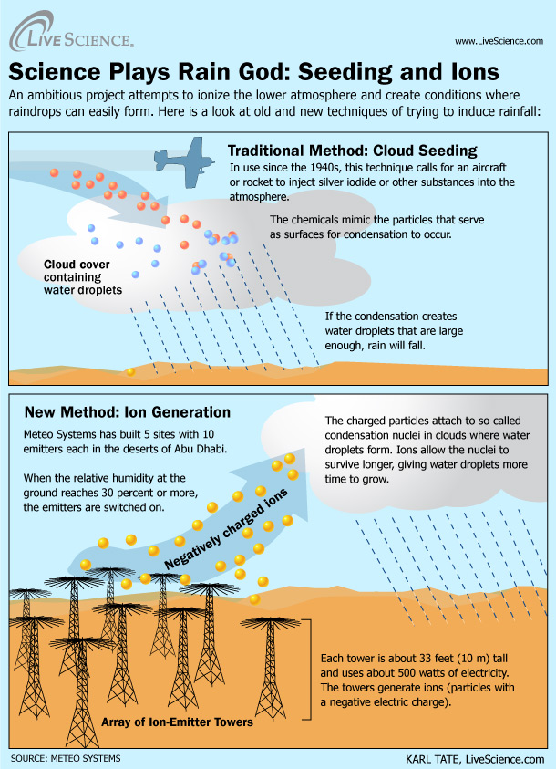
Cloud Ionizers – Electric Rainmaking
Notes:
https://climateviewer.com/2014/03/26/cloud-ionization-electric-rainmaking-laser-guided-weather-modification/
https://climateviewer.com/2014/02/02/blue-gold-rush-future-water-wars-using-rivers-troposphere/
WMO Expert Team on Weather Modification Statement on Ionizers
http://www.wmo.int/pages/prog/arep/wwrp/new/documents/WMR_documents.final_27_April_1.FINAL.pdf
http://www.wmo.int/pages/prog/arep/wwrp/new/weathermod_new.html

Slide 46
Notes:
“Terrorism, Weapons of Mass Destruction, and U.S. Strategy ”
Sam Nunn Policy Forum – April 28, 1997 University of Georgia, Athens, Georgia.
http://www.fas.org/news/usa/1997/04/bmd970429d.htm

Slide 47
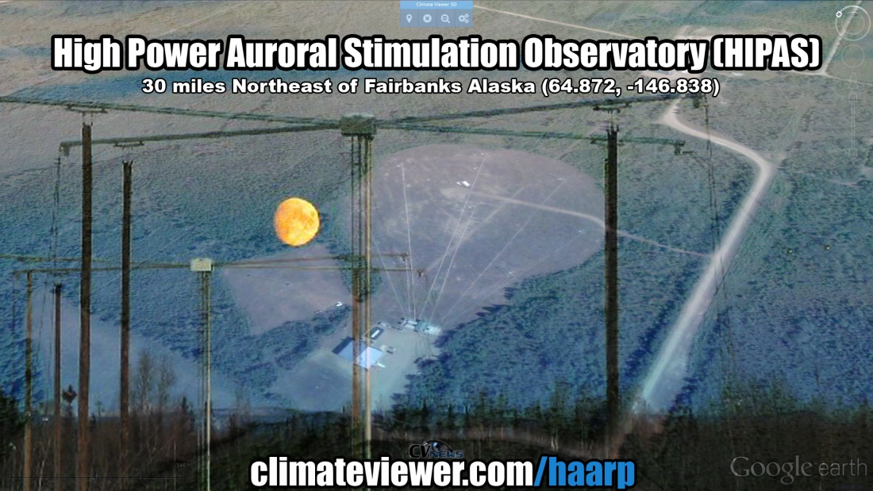
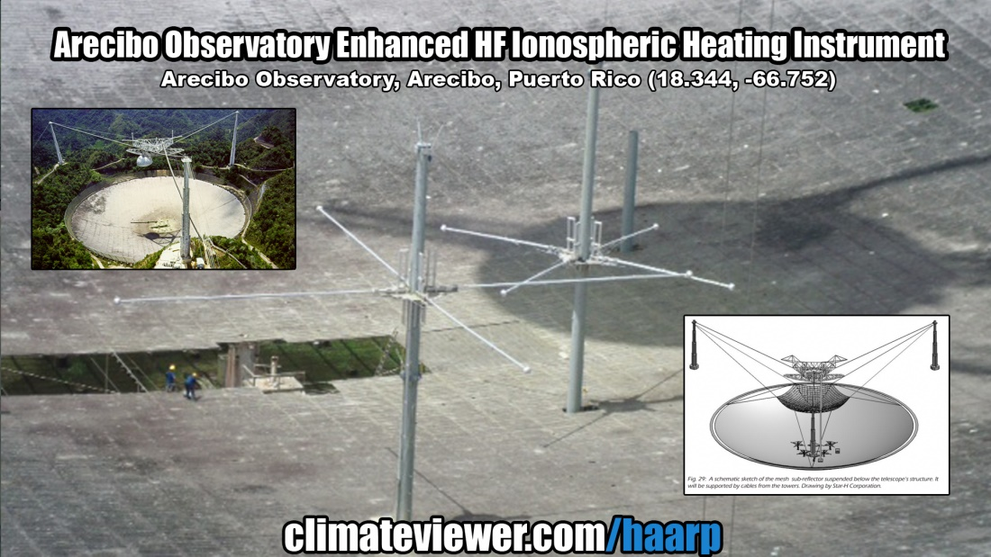
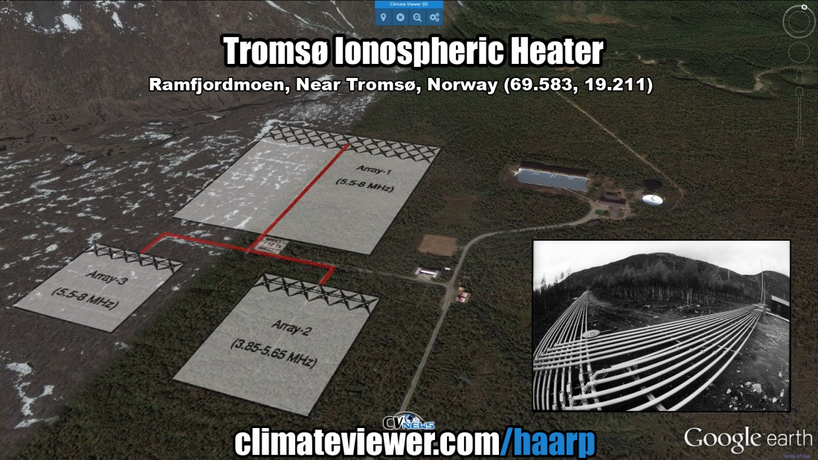
Ionospheric Heaters
Notes:
https://climateviewer.com/haarp/
https://climateviewer.com/2014/10/18/ionospheric-heaters-how-haarp-really-works/

Slide 48
HAARP IRI – Gakona, Alaska
Notes:
http://climateviewer.org/3D/index.html?layersOn=haarp&baseLayer=Bing%20Aerial&lat=-145.15053&lon=62.39722&zoom=4544.98&date=2016-11-28
https://climateviewer.com/haarp/
https://climateviewer.com/2014/10/18/ionospheric-heaters-how-haarp-really-works/

Slide 49
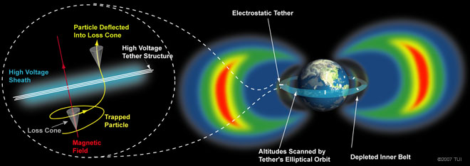
Radiation Belt Remediation aka Draining the Van Allen Belts
“we don’t think there is any downside to not having them [Van Allen belts]” says Dr. Jacob Bortnik, UCLA. “That’s the most any of us can really say at the moment.”
Notes:
https://climateviewer.com/2015/01/01/ionospheric-heaters-destroying-van-allen-belts/
Satellite Threat Due to High Altitude Nuclear Detonation – Eisenhower Institute – Papadopoulos-Presentation 280369
https://www.scribd.com/doc/134612875/Satellite-Threat-Due-to-High-Altitude-Nuclear-Detonation-Eisenhower-Institute-Papadopoulos-Presentation-280369
High-Voltage Orbiting Long Tether (HiVOLT): A System for Remediation of the Van Allen Radiation Belts
It remains uncertain as to whether removing these radiation belts might have unintended consequences.
“At present we don’t think there is any downside to not having them, but as with all things geophysical, it is hard to know all the complex interconnections between the various systems and estimate the full effect of removing the radiation belts completely,” Bortnik says.
“That’s the most any of us can really say at the moment.”
Can We Hack the Van Allen Belts?.” http://spectrum.ieee.org/aerospace/astrophysics/hacking-the-van-allen-belts

Slide 50
Notes:
http://spp.astro.umd.edu/SpaceWebProj/Invited%20Talks/Active%20Experiments-2013.pdf – Using Active Experiments to Probe Geospace, Dennis Papadopoulos, University of Maryland
http://spp.astro.umd.edu/SpaceWebProj/Invited%20Talks/Virtual%20ULF%20Antennea-2013.pdf – “Virtual ULF/ELF/VLF Ionospheric Antennae” Resolving Critcal Radiaton Belt & Geospace Issues, Dennis Papadopoulos, University of Maryland

Slide 51
Polar Electrojet PEJ Heating E Region
Notes:
http://spp.astro.umd.edu/SpaceWebProj/Invited%20Talks/Active%20Experiments-2013.pdf – Using Active Experiments to Probe Geospace, Dennis Papadopoulos, University of Maryland
http://spp.astro.umd.edu/SpaceWebProj/Invited%20Talks/Virtual%20ULF%20Antennea-2013.pdf – “Virtual ULF/ELF/VLF Ionospheric Antennae” Resolving Critcal Radiaton Belt & Geospace Issues, Dennis Papadopoulos, University of Maryland

Slide 52
Notes:
http://spp.astro.umd.edu/SpaceWebProj/Invited%20Talks/Active%20Experiments-2013.pdf – Using Active Experiments to Probe Geospace, Dennis Papadopoulos, University of Maryland
http://spp.astro.umd.edu/SpaceWebProj/Invited%20Talks/Virtual%20ULF%20Antennea-2013.pdf – “Virtual ULF/ELF/VLF Ionospheric Antennae” Resolving Critcal Radiaton Belt & Geospace Issues, Dennis Papadopoulos, University of Maryland

Slide 53
Ionospheric Current Drive ICD Heating
Notes:
http://spp.astro.umd.edu/SpaceWebProj/Invited%20Talks/Active%20Experiments-2013.pdf – Using Active Experiments to Probe Geospace, Dennis Papadopoulos, University of Maryland
http://spp.astro.umd.edu/SpaceWebProj/Invited%20Talks/Virtual%20ULF%20Antennea-2013.pdf – “Virtual ULF/ELF/VLF Ionospheric Antennae” Resolving Critcal Radiaton Belt & Geospace Issues, Dennis Papadopoulos, University of Maryland

Slide 54
Notes:
https://climateviewer.com/2014/10/22/haarp-boat-ionospheric-heaters-go-mobile/
http://spp.astro.umd.edu/SpaceWebProj/Invited%20Talks/Barge%20Based%20ELF-2010.pdf – “On the Viability and Requirements of a Barge Based ELF System” Dennis Papadopoulos, University of Maryland, College Park, December 21, 2010

Slide 55
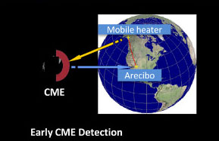
Notes:
https://climateviewer.com/2014/10/22/haarp-boat-ionospheric-heaters-go-mobile/
http://spp.astro.umd.edu/SpaceWebProj/Invited%20Talks/Barge%20Based%20ELF-2010.pdf – “On the Viability and Requirements of a Barge Based ELF System” Dennis Papadopoulos, University of Maryland, College Park, December 21, 2010
http://www.ipr.umd.edu/sites/default/files/documents/Papadopoulos%20.pdf – “Mobile HF Sources Research & Applications” Physics of Ionospheric Modification, Theory & Laboratory Experiments, Dennis Papadopoulos – Gennady Milikh, University of Maryland, College Park, AFOSR MURI Kick­Off March 12, 2014

Slide 56
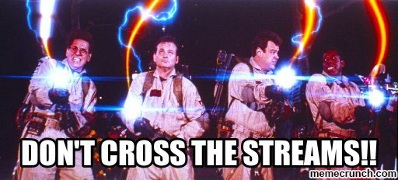
Project LUCY in the Sky with Diamonds “noctilucent clouds formed from the breakdown of methane in a circular zone above the HAARP transmitter”
Notes:
https://climateviewer.com/2014/04/01/haarp-lucy-sky-diamonds/
ANGELS Proposal
https://docs.google.com/presentation/d/1vOw215pGuiob9q-u0VRrc2Uumfxr8xU3s4Q2k_YNdsE/edit#slide=id.p4
Arctic Methane Emergency Group – AMEG
http://ameg.me/
AMEG letter to world leaders begging for Geoengineering in 2013
http://ameg.me/images/ameg-strategic-plan.pdf
“Following the launch of AMEG’s ‘Strategic Plan’ the above actions will be communicated to all world leaders and relevant parties in the form of an ‘Essential Action Plan’ to match the pending circumstances of the change in the world’s weather patterns.”
UK Government Response to AMEG’s call for Geoengineering
http://www.publications.parliament.uk/pa/cm201213/cmselect/cmenvaud/858/85804.htm
AMEG Responds to UK Governments shunning: http://ameg.me/index.php/2-ameg/48-government-response-to-eac-based-on-non-existing-observations-says-ameg

Slide 57
GEOENGINEERING
AKA
CLIMATE ENGINEERING
AKA
CLIMATE INTERVENTION
Notes:
https://climateviewer.com/geoengineering/

Slide 58
Terminology
Solar Radiation Management (SRM)
Stratospheric Aerosol Injection (SAI)
Marine Cloud Brightening (MCB)
Thermal Radiation Management (TRM)
Short Wave Climate Engineering (SWCE)

Slide 59
Terminology – Google Scholar Results
geoengineering [25,200 results]
weather modification [20,900 results]
weather control [4,130 results]
climate modification [5,310 results]
climate engineering [2,460 results]
climate intervention [119 results]
ecological alteration [366 results]
albedo modification [531 results]
albedo enhancement [1,580 results]
solar radiation management [1,470 results]
stratospheric aerosol injection (SAI) [173 results]
stratospheric aerosol geoengineering (SAG) [84 results]
Notes:
https://climateviewer.com/2015/03/06/re-branding-geoengineering-climate-intervention-and-gatekeeping/

Slide 60
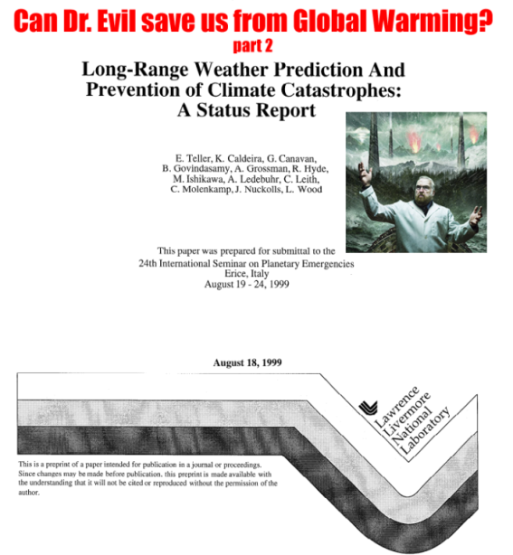
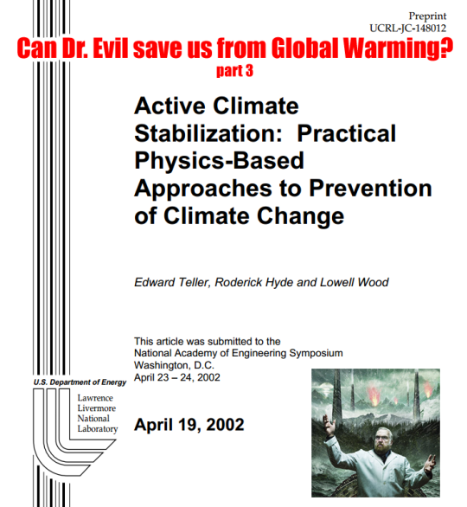
Can Dr. Evil Save Us From Global Warming?
Notes:
August, 1997 - Global Warming and Ice Ages – Prospects for Physics-Based Modulation of Global Change
Dr. Evil's Geoengineering Plan (part 1) by Edward Teller, Lowell Wood, Roderick Hyde. Lawrence Livermore National Laboratory.
References
http://dge.stanford.edu/labs/caldeiralab/Caldeira%20downloads/Teller_etal_LLNL231636_1997.pdf
August 19-24, 1999 - Long-Range Weather Prediction And Prevention of Climate Catastrophes – A Status Report
Dr. Evil's Geoengineering Plan (part 2) by Edward Teller, Lowell Wood, Roderick Hyde, and Ken Caldeira. Lawrence Livermore National Laboratory.
References
http://dge.stanford.edu/labs/caldeiralab/Caldeira%20downloads/Teller_etal_LLNL236324_1999.pdf
April 19, 2002 - Active Climate Stabilization – Practical Physics-Based Approaches to Prevention of Climate Change
Dr. Evil's Geoengineering Plan (part 3) by Edward Teller, Lowell Wood, Roderick Hyde. Lawrence Livermore National Laboratory.
References
http://web.archive.org/web/20070611194418/http://www.llnl.gov/global-warm/148012.pdf
http://r3zn8d.files.wordpress.com/2013/03/active-climate-stabilization-practical-physics-based-approaches-to-prevention-of-climate-change.pdf
August, 2006 - Stratospheric sulfur injection to reflect sunlight
Albedo Enhancement by Stratospheric Sulfur Injections – A Contribution to Resolve a Policy Dilemma by Nobel prize winner Paul J. Crutzen
References
http://link.springer.com/article/10.1007%2Fs10584-006-9101-y?LI=true

Slide 61
Geoengineering SRM Funding
Notes:
https://climateviewer.wordpress.com/2013/10/09/bill-gates-funds-geoengineering-studies/
Grants for (geoengineering programs) research are provided to the University of Calgary from gifts made by Mr. Bill Gates from his personal funds. The activities of the Fund for Innovative Climate and Energy Research fall outside the scope of activities of the Bill & Melinda Gates Foundation. FICER is not a Foundation project and has no relationship with it.
The fund has supported research in a wide range of areas. Some examples include: 1. understanding carbon dioxide emissions associated with international trade in goods and services; 2. developing technologies to capture carbon dioxide out of the air; and 3. climate modeling to understand possible environmental consequences of solar radiation management

Slide 62
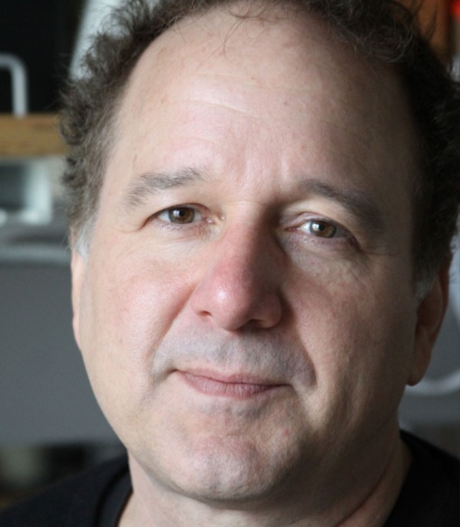
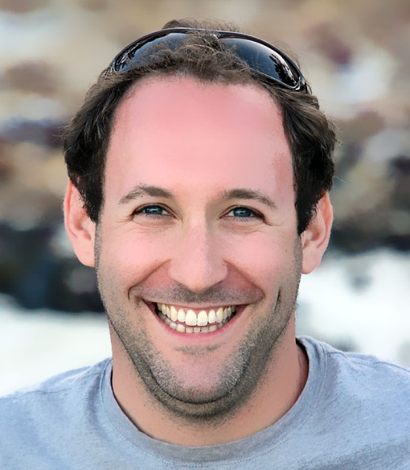
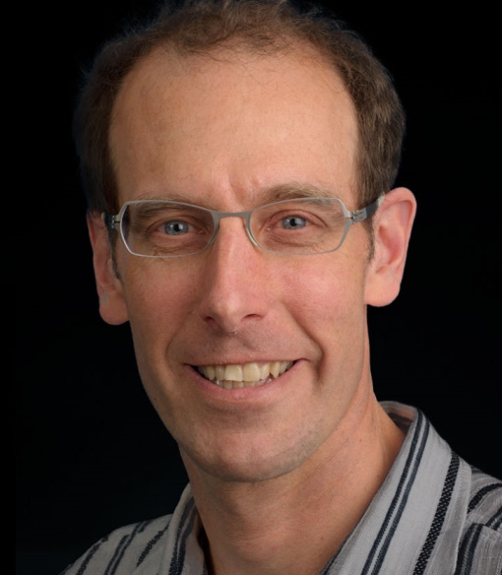
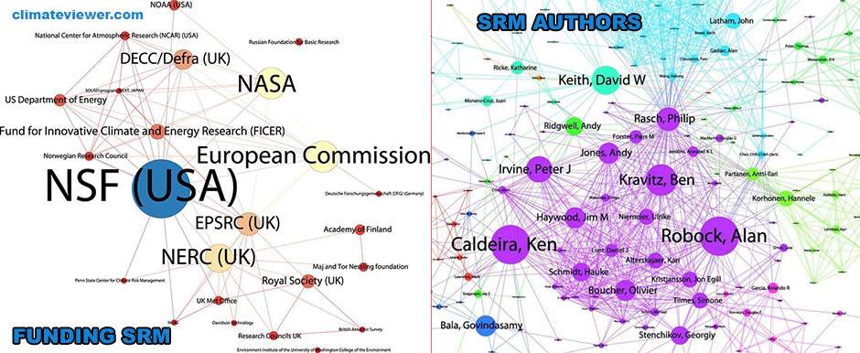
Geoengineering SRM Lobbyists
Ken Caldeira
Alan Robock
Ben Kravitz
David Keith
Notes:
Oldham P, Szerszynski B, Stilgoe J, Brown C, Eacott B, Yuille A. 2014. Mapping the landscape of climate engineering. Phil. Trans. R. Soc. A 372, 20140065 (doi:10.1098/rsta.2014.0065) [PMC free article][PubMed]
http://dx.doi.org/10.1098/rsta.2014.0065
http://www.ncbi.nlm.nih.gov/pmc/articles/PMC4240957/
http://www.ncbi.nlm.nih.gov/pubmed/25404683

Slide 63
Geoengineering SRM Projects
The Silver Lining Project - Marine Cloud Brightening
Notes:
https://climateviewer.com/2013/10/09/the-silver-lining-project-cloud-making-boats-ocean-pumps-to-halt-hurricanes/
The Silver Lining Project is a not-for-profit international scientific research collaboration to study the effects of particles (aerosols) on clouds, and the influence of these cloud effects on climate systems. [1]
Research Objectives: Fill important gaps in the understanding of cloud dynamics and systems to improve climate models - Advance understanding of the climate effects of pollution in clouds - Research basic processes associated with adding natural aerosols to clouds to impact climate (e.g. Marine Cloud Brightening) - Understand the principles behind technologies for adding natural aerosols to cloud systems [2] - This research is currently undertaken by distinguished scientists and engineers at: Manchester University, Leeds University, NCAR, Pacific Northwest National Labs, Purdue University, University of Washington and the University of Edinburgh [3]. Silver Lining Project - One Market Street, Suite 3500. San Francisco, California 94105 phone: +1 (415) 681-8000 fax: +1 (415) 651-8932 Email: info@silverliningproj.org [4] [1] silverliningproj.org/index.html [2] silverliningproj.org/research.html [3] silverliningproj.org/collaborators.html [4] silverliningproj.org/contact.html

Slide 64
Geoengineering SRM Projects
The Stratoshield "Hose to the Sky"
Notes:
https://climateviewer.com/2013/10/10/the-stratoshield-hose-to-the-sky-could-reverse-global-warming/

Slide 65
Geoengineering SRM Projects
Stratospheric Particle Injection for Climate Engineering SPICE
Notes:
https://climateviewer.com/2013/10/06/geoengineering-programs-weather-modification-experiments/

Slide 66
Notes:
https://climateviewer.com/2014/04/01/hard-look-perils-potential-geoengineering/

Slide 67
Geoengineering Will Kill People
“It is likely that any SRM geoengineering intervention will create winners and losers and some nations may always be against any intervention whatsoever.”
“In any given year there are floods, droughts, heatwaves, etc. but during this field trial a fraction of these events would be attributed (rightly or wrongly, partially or fully) to the intervention. Two questions arise:”
“Could it be determined if any changes in the climate (outside of the target area) had occurred as a result of the intervention during a 10 year trial?”
“How would aggrieved nations or peoples seek reparations for perceived negative impacts (scientifically proven or otherwise)?”
- Pete Irvine, PhD student. School of Geographical Sciences, University of Bristol.
Notes:
https://groups.google.com/d/msg/geoengineering/ipdLpbnXHeU/tAXDtadrNR0J

Slide 68
Geoengineering Will Kill People
- the solar geoengineering led to serious side-effects, e.g., reduced rainfall over the semi-arid area south of the Sahara desert
- When when solar geoengineering stopped, the climate rapidly rebounded
- we cannot tell how much cooling was caused by solar geoengineering and how much resulted from natural climate variability, e.g. volcanic eruptions”
- Integrated Assessment of Geoengineering Proposals
Notes:
DECISION-MAKING FOR GEOENGINEERING: WHY WILL IT BE CHALLENGING?
The third of a set of four Briefing Notes summarizing the findings of the Integrated Assessment of Geoengineering Proposals
http://www.iagp.ac.uk/sites/default/files/IAGP_Briefing_Note_3.pdf
“The ability to accurately detect and attribute changes in the climate should be a prerequisite for implementing geoengineering”
To facilitate more accurate detection and attribution of changes in the Earth’s climate, there needs to be significant improvements to the coverage and quality of observations along with the co-ordinated development of computer simulations.
To better appreciate the real-world complexities associated with geoengineering, decision-makers should have access to interactive simulators similar to the one used in the IAGP Arctic sea ice study
Geoengineering in the Arctic: Defining the Governance Dilemma
https://pdfs.semanticscholar.org/54e5/69b046742da3edd652976c1f4175319c1ff2.pdf
Deployment of SRM techniques to slow melting of the Arctic ice sheet carries significant risks and uncertainties, and thus raises multiple difficulties for its governance. One suggested technique, shooting sulfate aerosols into the stratosphere, could lead to ozone depletion (Tilmes et al. 2008). This kind of depletion “could disrupt the Asian and African summer monsoons, reducing precipitation to the food supply for millions of people” (Robock et al. 2008). Thus, the consequences of injecting sulfate aerosols could impact 700 million inhabitants in the northern hemisphere, not merely the 4 million inhabitants of the Arctic region (Maté 2002). Scientists have also suggested injecting soot into the stratosphere, since it has comparable scattering properties to sulfate aerosols (Crutzen 2006). This, however, would result in blackening the Arctic snow and possibly, accelerated melting of the ice sheet. These technologies could also have other implications, positive or negative, that have still not been fully assessed. In order to identify these implications, these technologies will need to be deployed on a large scale.

Slide 69
Geoengineering Ban
that no climate-related geo-engineering activities** that may affect biodiversity take place, until there is an adequate scientific basis on which to justify such activities and appropriate consideration of the associated risks for the environment and biodiversity and associated social, economic and cultural impacts, with the exception of small scale scientific research studies that would be conducted in a controlled setting – Convention for Biological Diversity, Climate-related Geoengineering and Biodiversity, 2012
“The U.S. is not a party to the 1992 accord and thus was NOT officially involved in the geoengineering decision.”
Notes:
https://www.cbd.int/climate/geoengineering/
** footnote to decision X/33 para 8 (w): Without prejudice to future deliberations on the definition of geo-engineering activities, understanding that any technologies that deliberately reduce solar insolation or increase carbon sequestration from the atmosphere on a large scale that may affect biodiversity (excluding carbon capture and storage from fossil fuels when it captures carbon dioxide before it is released into the atmosphere) should be considered as forms of geo-engineering which are relevant to the Convention on Biological Diversity until a more precise definition can be developed. It is noted that solar insolation is defined as a measure of solar radiation energy received on a given surface area in a given hour and that carbon sequestration is defined as the process of increasing the carbon content of a reservoir/pool other than the atmosphere
October 2016
https://www.cbd.int/doc/publications/cbd-ts-84-en.pdf

Slide 70
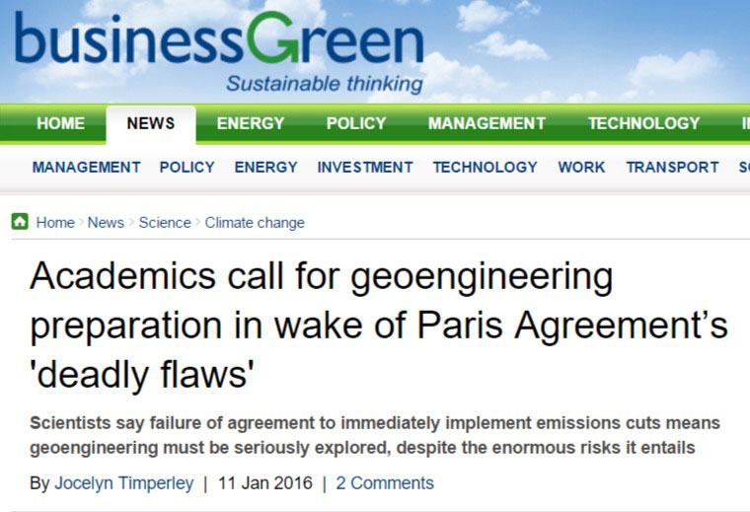
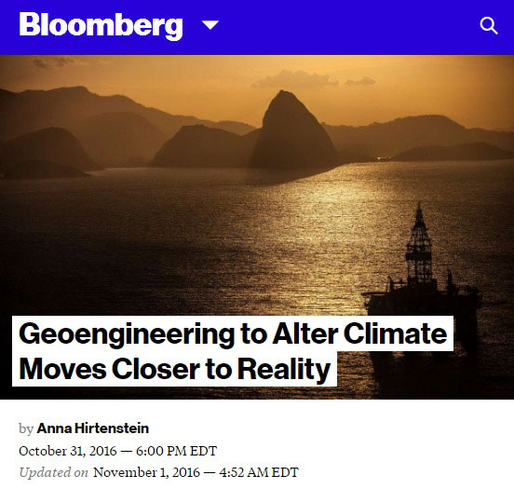
Geoengineering and COP21
“Within the Paris agreement there’s an implicit assumption that there will need to be greenhouse gases removed,” said Phil Williamson, a scientist at the U.K.’s University of East Anglia, who worked on the report. “Climate geoengineering is what countries have agreed to do, although they haven’t really realized that they’ve agreed to do it.”
Notes:
“We’re not going to launch a big effort before Paris;”
https://climateviewer.com/2016/10/18/hillary-clinton-supports-geoengineering-err-climate-intervention/
"Our backs are against the wall and we must now start the process of preparing for geo-engineering, the letter said. "We must do this in the knowledge that its chances of success are small and the risks of implementation are great."
The Paris Agreement commits countries to a system of volutary national climate action plans, which will be reviewed every five years in a bid to keep average global temperature increases well below 2C and ideally below 1.5C. However, according to official estimates current national plans will result in temperature increases of almost 3C this century and the letter dismisses the idea far more ambitious plans and targets will be agreed in five years as "naïve".
References
http://news.berkeley.edu/2015/12/14/does-the-paris-agreement-open-the-door-to-geoengineering/
http://www.slate.com/blogs/future_tense/2015/12/14/is_geoengineering_necessary_to_meet_paris_cop21_climate_temperature_goals.html
http://www.bbc.com/news/science-environment-35109198
http://www.businessgreen.com/bg/news/2441233/academics-call-for-geoengineering-preparation-in-wake-of-paris-agreement-s-deadly-flaws

Slide 71
Geoengineering Is Already Happening
“The emissions and the climate change that we’re causing with that is already a massive experiment on our world that we don’t really know the outcome of. So I don’t think we should start another set of experiments and go into geoengineering. I think we should get our act together and reduce our emissions.” U.N. Assistant Secretary-General Janos Pasztor
Notes:
http://www.weather.com/news/climate/news/geoengineering-paris-climate-conference-talks

Slide 72
Geoengineering Is Already Happening “ARTIFICIAL CLOUDS” – Ship Tracks
MODIS Terra Corrected Reflectance
3-6-7 band - January 30, 2013
Notes:
http://climateviewer.org/3D/index.html?layersOn=MODIS_Terra_CorrectedReflectance_Bands367&baseLayer=Dark%20Matter&lat=-130.45279&lon=37.51724&zoom=1099418.71&date=2013-01-30

Slide 73
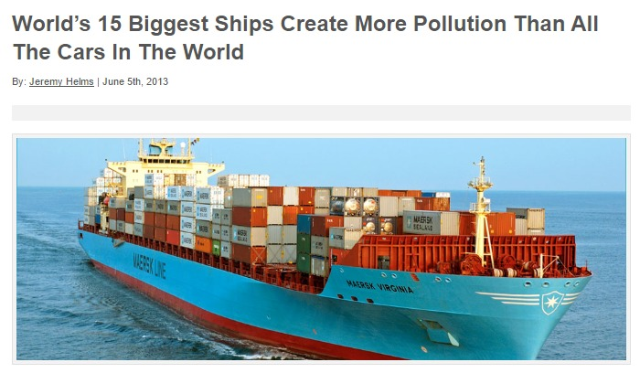
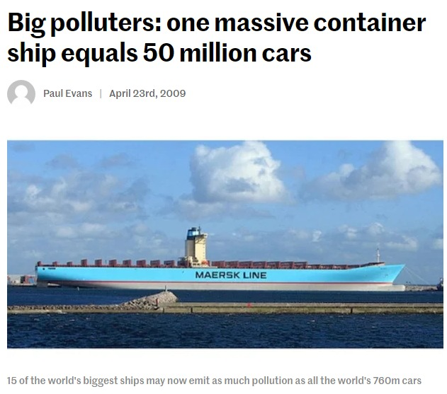
Geoengineering Is Already Happening “ARTIFICIAL CLOUDS” – Ship Tracks
BUNKER FUEL - “The real issue lies with the heavy fuel oil the ships run on and the almost complete lack of regulations applied to the giant exhaust stacks of these container ships.”
Notes:
http://www.dailymail.co.uk/sciencetech/article-1229857/How-16-ships-create-pollution-cars-world.html
http://newatlas.com/shipping-pollution/11526/
http://www.industrytap.com/worlds-15-biggest-ships-create-more-pollution-than-all-the-cars-in-the-world

Slide 74
Geoengineering Is Already Happening “ARTIFICIAL CLOUDS” – Contrail Cirrus
A case study of the radiative forcing of persistent contrails evolving into contrail-induced cirrus
March 20, 2009
Notes:
The pictures show satellite thermal images of the evolving contrail. This was from a case study published by Jim Haywood and colleagues in JGR doi:10.1029/2009JD012650.
http://onlinelibrary.wiley.com/doi/10.1029/2009JD012650/abstract

Slide 75
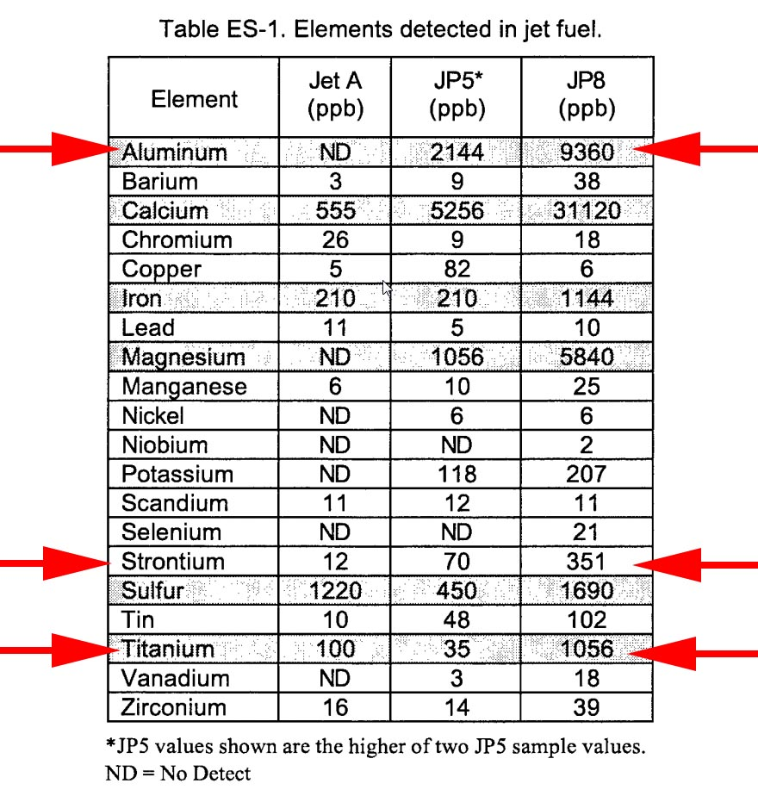
“Chemtrails”
Stadis 450 DINNSA = Dinonylnaphthylsulfonic acid
Barium Fuel Additive = Anti-Static Agent used since 1962
Notes:
https://climateviewer.com/2014/11/05/contrails-geoengineering-single-fuel-concept/
https://climateviewer.com/chemtrails/
https://climateviewer.com/2016/09/16/the-chemtrail-conspiracy-bombshell-secret-agenda-explained/
Trace Element and Polycyclic Aromatic Hydrocarbon Analyses of Jet Engine Fuels: Jet A, JP5, and JP8: http://www.dtic.mil/cgi-bin/GetTRDoc?AD=ADA396143
Spray Visualization of Alternative Aviation Turbine Fuel embedded with Metallic Nanoparticles
http://www.psfvip10.unina.it/Ebook/web/papers/110_PSFVIP10.pdf
Energetic Nanoparticles as Fuel Additives for Enhanced Performance in Propulsion Systems
http://etd.lsu.edu/docs/available/etd-07132012-105303/unrestricted/SKarmakar_Disstn_final3.pdf
Reduction of emissions and fuel consumption in a compression ignition engine using nanoparticles
Nanoparticles increase biofuel performance
http://www.bioline.org.br/pdf?st15211
Why add nanoparticles? The idea, says lead author R. B. Anand, an associate professor of mechanical engineering at the National Institute of Technology in Tiruchirappalli, India, is that because of their high surface-to-volume ratio, the nanoparticles—which, in the study, had an average diameter of 51 billionths of a meter—have more reactive surfaces, allowing them to act as more efficient chemical catalysts, thus increasing fuel combustion. The presence of the particles also increases fuel–air mixing in the fuel, which leads to more complete burning.
In the study, Anand and co-author J. Sadhik Basha first used a mechanical agitator to create an emulsion consisting of jatropha biodiesel (a fuel derived from the crushed seeds of the jatropha plant), water, and a surfactant, then blended in different proportions of alumina nanoparticles. In addition to outperforming regular biofuel, the nanoparticle-spiked fuels produced significantly lower quantities of nitrogen oxide and carbon monoxide gases, and created less smoke.
The researchers are now testing other types of nanoparticles, including hollow carbon nanotubes, and investigating the effects of nano-additives to engine lubrication and cooling systems. One obstacle to the application of this kind of nanotechnology is the high cost of nanoparticle production, says Anand—who also cautions that nanoparticles “should be used judiciously,” because they tend to “entrain into human bodies.“ Read more at: http://phys.org/news/2011-04-nanoparticles-biofuel.html

Slide 76
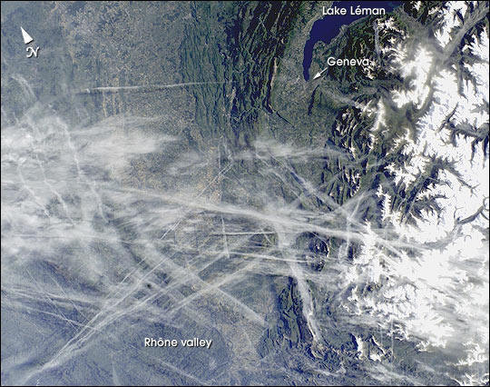
Terminology – Credibility is Crucial
Chemtrails
Persistent Contrails
Spreading Contrails
Contrail Cirrus
Contrail Induced Cloudiness
Aviation Induced Cloudiness
Aviation Induced Cirrus
Induced Cirrus Cloudiness
Man-made clouds
Artificial Clouds
Sky Brightening
Ice Haze
Notes:
All same thing…

Slide 77
Jet Aircraft “Accidental Geoengineering”
"I'm talking about a sub-visual contrail-generated haze of ice, which we do not classify as a cloud but gives blue sky more of a whitish tint."
Chuck Long, a CIRES researcher at NOAA/ESRL's Global Monitoring Division
Notes:
VIDEO: https://www.youtube.com/watch?v=jHJgV6JQVd0
https://www.linkedin.com/in/chuck-long-97573b65
http://climateviewer.com/chemtrails/
The History of Artificial Clouds: How to Geoengineer a Planet with Jet Fuel
https://climateviewer.com/2015/08/08/the-history-of-artificial-clouds-how-to-geoengineer-a-planet-with-jet-fuel/
Accidental Geoengineering? Airline traffic may help create an icy haze that’s brightening U.S. skies. December 15, 2015
http://www.esrl.noaa.gov/news/2015/121515.html
Airplane Contrails May Be Creating Accidental Geoengineering
http://www.smithsonianmag.com/science-nature/airplane-contrails-may-be-creating-accidental-geoengineering-180957561/?no-ist
Jet traffic linked to ice haze
http://www.bbc.com/news/science-environment-35109198
Ken Caldeira and Mick West argue over what geoengineering would look like:
https://groups.google.com/d/msg/geoengineering/3tkTYsugQTw/im_1nFPyS0wJ

Slide 78
Sulfuric Acid from Aviation and Ship Tracks may be higher today than Geoengineering SRM would require in 2020
“25,000 metric tons of sulfuric acid to cut global warming in half after one year.” – David Keith
“1990 global aviation’s annual contribution to the atmospheric sulfur budget by aircraft of 2.E7 kg H2SO4 (20,000 metric tons) . …by 2010 Aviation emissions could had [sic] been up 110%”
“So perhaps those in the GE community who are genuinely opposed to geoengineering should revise their premises and call for research into GE with the purpose of ending this ‘unintended’, but failed and still ongoing experiment.” – Oscar Escobar
Notes:
http://geoengineeringclimateissues.blogspot.com/2013/11/h2so4-sulfuric-acid-from-aviation-may.html
https://climateviewer.com/2014/01/31/sulfuric-acid-aviation-ship-tracks-may-higher-today-geoengineering-srm-require-2020/

Slide 79
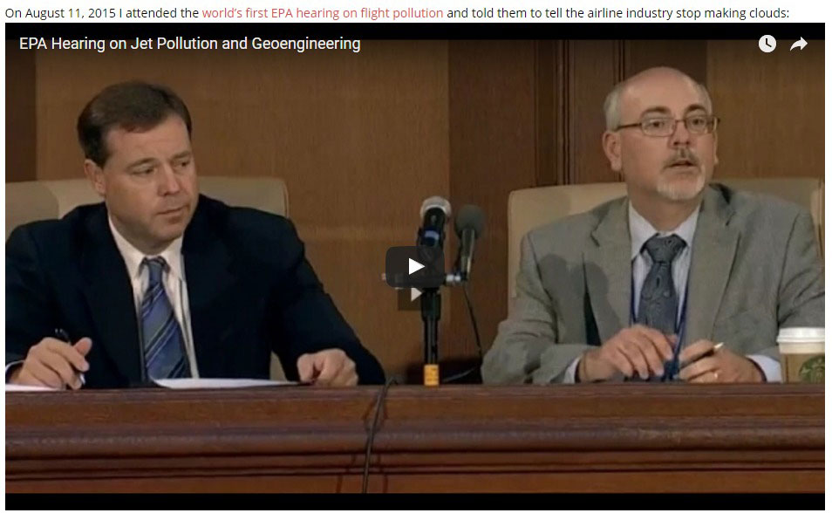
Activists Take On Artificial Clouds At US EPA Hearing on Jet Pollution – September 2015
July 25, 2016 – BREAKING: EPA To Limit Greenhouse Gases From Airplanes
July 31, 2016 – White House releases “Federal Alternative Jet Fuel Research and Development Strategy”
September 3, 2016 – China, U.S. and Europe pledge support for global aviation emissions pact
September 12, 2016 – Greens move to dismiss EPA lawsuit over airplane emissions
Notes:
https://www.youtube.com/watch?v=yY1_NvWKNi8
https://climateviewer.com/2014/12/30/hate-chemtrails-act-now-earthjustice-sues-epa/
https://climateviewer.com/2015/07/26/worlds-first-epa-public-hearing-on-flight-pollution-speak-now/
https://climateviewer.com/2015/08/09/my-speech-to-the-epa-about-flight-pollution/
https://climateviewer.com/chemtrails/
I was the only person who called the EPA demanding a hearing and Senior Policy Analyst Lucie Audette called me to try and talk me out of coming:
https://www.youtube.com/watch?v=zxFhSk620dw
http://web.archive.org/web/20150906001353/http://www.epa.gov/otaq/documents/aviation/us-ghg-endangerment-ip-9-3-14.pdf
The Environmental Protection Agency took a step towards adding aircraft emissions to the list of regulated pollution sources. In a statement the EPA said it will study the issue of greenhouse gas emissions from aircraft, the first step in the regulatory process, and release its findings by next April. If the agency finds airline emissions to be a risk to public health or the environment, it will begin the process of crafting rules. The rules would make airplanes subject to carbon emissions guidelines in a process similar to the one currently underway for vehicles and power plants.
https://thinkprogress.org/breaking-epa-to-limit-greenhouse-gases-from-airplanes-32e27fccf147
http://www.biofuelsdigest.com/bdigest/2016/07/31/white-house-releases-federal-alternative-jet-fuel-research-and-development-strategy/
http://www.reuters.com/article/us-eu-climate-aviation-idUSKCN1190M2
http://thehill.com/policy/energy-environment/295401-greens-move-to-dismiss-epa-lawsuit-over-airplane-emissions

Slide 80
Artificial Cloud Experimentation
Notes:
https://climateviewer.com/2015/08/08/the-history-of-artificial-clouds-how-to-geoengineer-a-planet-with-jet-fuel/
http://web.archive.org/web/20150314160918/http://www.apropos.fi/Tiedostot/Tiedostot/FICCA/FICCA%2016.04.2013/Posters/FICCA_poster_Partanen_COOL.pdf
http://web.archive.org/web/20150314161010/http://www.aka.fi/en-GB/A/Programmes-and-cooperation/Academy-programmes/Etusivun-elementit/Researchers-look-into-geoengineering-possibilities/
http://www.atmos-chem-phys.net/16/10521/2016/acp-16-10521-2016.pdf
Cirrus Cloud Seeding
https://www.youtube.com/watch?v=ND8hk5xp2Bg
https://ams.confex.com/ams/95Annual/webprogram/Paper268699.html
http://folk.uib.no/ngfhd/EarthClim/Calendar/Oslo-2012/Muri_EarthClim_2012.pdf
http://www.ncbi.nlm.nih.gov/pubmed/25404685
http://www.spp-climate-engineering.de/symposium-blog-single/items/day-1-could-we.html

Slide 81
Geoengineering Is Already Happening Could We Detect “Rogue Geoengineering?”
“I got a phone call from two men who said we work as consultants for the CIA and we’d like to know if some other country was controlling our climate, would we know about it?
“I told them, after thinking a little bit, that we probably would.”
Alan Robock
Notes:
https://climateviewer.com/2015/02/22/the-cia-weather-warfare-and-climate-terrorism/
http://www.dailymail.co.uk/wires/pa/article-2954051/Chill-factor-CIA-weather-query.html
https://www.youtube.com/watch?v=tYqG4KV951g

Slide 82
Geoengineering Is Already Happening Could We Detect “Rogue Geoengineering?”
Dian J. Seidel – NOAA, speaking January 6, 2015 at the 20th Conference on Planned and Inadvertent Weather Modification
Notes:
Seidel, D. J., G. Feingold, A. R. Jacobson, and N. Loeb, 2014: Detection limits of albedo changes induced by climate engineering. Nature Climate Change, 4, 93-98. doi:10.1038/NCLIMATE2076.
https://ams.confex.com/ams/95Annual/webprogram/Paper260558.html
https://www.youtube.com/watch?v=9_2yXbKUaUM

Slide 83
Geoengineering/ENMOD Solution
Verification
and
Transparency
The Clarity Clause

Slide 84
Clarity: A Sustained Observing System
Citizen-Powered Sensor Network
Notes:
http://climateviewer.org/
http://climateviewer.org/about/
https://www.gofundme.com/climateviewer

Slide 85
Clarity: A Sustained Observing System
Detect Atmospheric Conditions
All-sky camera (streaming video)
Aerosol detection, analysis, and live display (nanoparticles, radioactivity, chemical composition)
Citizen-Powered Sensor Network
Notes:
http://climateviewer.org/
http://climateviewer.org/about/
https://www.gofundme.com/climateviewer

Slide 86
Clarity: Transparency
Create a “multilateral registry of cloud seeding, geoengineering, and atmospheric experimentation events with information and data collection on key characteristics” and publish hourly updates on activities to a publicly available website.
Require nations/states/persons to notify the multilateral registry (at least) 24 hours prior to initiation of atmospheric experimentation/modification to ensure public notice and liability should said experimentation/modification cause monetary, environmental, or physical losses.
Citizen-Powered Sensor Network
Notes:
http://climateviewer.org/
http://climateviewer.org/about/
https://www.gofundme.com/climateviewer

Slide 87
Thank you!
Please Support ClimateViewer
Sharing is Caring
CLIMATEVIEWER.COM
CLIMATEVIEWER.ORG
WEATHERMODIFICATIONHISTORY.COM
Support: www.gofundme.com/climateviewer
Subscribe: YouTube.com/jimleeclimateviewer
Contact: jim@climateviewer.com
This presentation is Creative Commons Non-Commercial 3.0. Feel free to share this anywhere as long as you provide a link back to https://climateviewer.com/geoengineering/
Notes:
Spread the word and THANK YOU!

